Slide 1
Open-Source Dynamic Traffic Assignment Package
DTALite/NEXTA
Xuesong (Simon) Zhou
xzhou99@gmail.com
xzhou74@asu.edu

Slide 2
Workshop Purpose and Objectives
Purpose
Educate workshop attendees on Dynamic Traffic Assignment modeling through hands-on exercises using the open-source DTALite software tool
Learning Objectives
Understand basic modeling approaches in DTALite
Import data to code and modify a subarea network
Evaluate simulation results using the visualization and reporting features in NeXTA
Notes:
The purpose of the workshops is to educate attendees on Dynamic Traffic Assignment modeling using hands-on exercises with the open-source DTALite software tool. In general, the workshop will focus on understanding basic modeling approaches in DTALite, importing data in NeXTA, analyzing toll facilities and work zones, and evaluating simulation results using visualization and reporting features in NeXTA.

Slide 3
Outline
Module 1: Introduction to DTALite/NeXTA
Module 2: Introduction to DTA modelling principles
Module 3: Visualization Features in NeXTA
Module 4: Introduction to Workshop Exercises
Notes:
As I just mentioned, the webinar is divided into four parts, referring to four separate videos which make up this recorded session. This is the first session, where we’ll introduce you to DTALite and NeXTA, and provide an overview of our project development so far.

Slide 4
Module 1 Introduction to DTALite/NeXTA
1.1 Project Objective and Motivations
1.2 What NeXTA/DTALite Can Do
1.3 Open-source Free Software Package

Slide 5
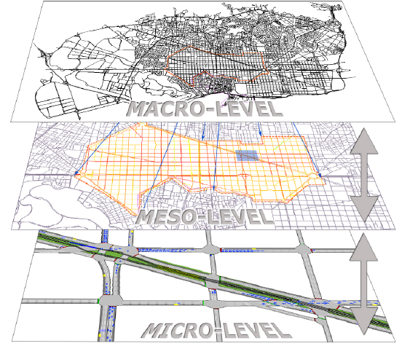
Mesoscopic Traffic Simulation

Slide 6
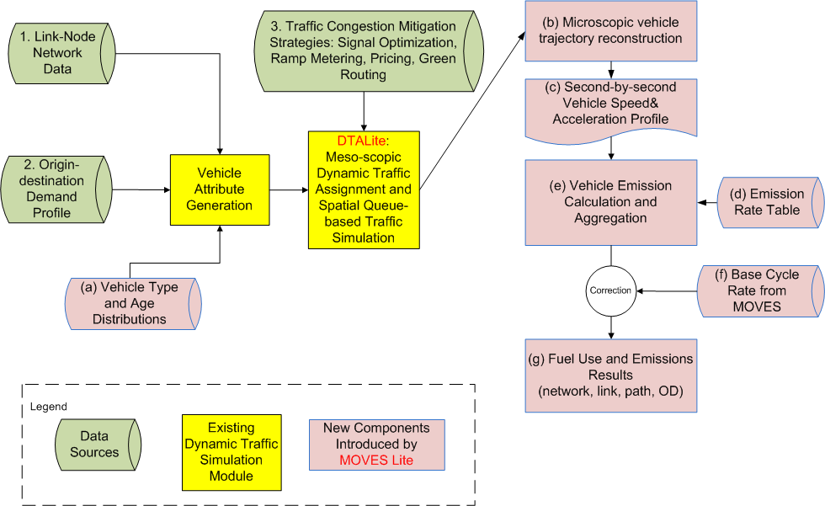
System Architecture and Data Flow

Slide 7
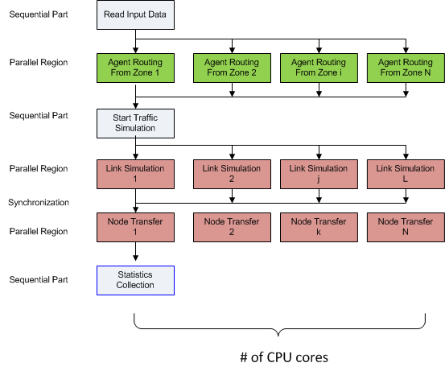
Computational Efficiency

Slide 8
1.0 Traffic Flow Theoretical Foundation: LWR Equations
Hyperbolic system of conservation laws
where q, k are flow and density, respectively, and g(·) is the net vehicle generation rate.
Traffic flow model
Speed (or flow) of traffic is a function of density only
E.g. Greenshields model: V = V_{free} (1 – k/K_{jam})

Slide 9
Numerical Calculation Scheme Based on Link Flow/Density (Used in CTM)
Notation
Δt = length of simulation interval (e.g. 1 sec, 6 sec)
Δx = cell length (e.g. 0.5 mile)
k_{i,t} , v_{i,t} =the prevailing density and mean speed in cell i during the t^{th} time step
q_{i,t} = transfer flow rate from section i to cell i+1 during the t^{th} time interval [t, t+Δt].
Computation Procedure
Step 1: Calculate prevailing speed v_{i,t} according to a traffic flow model
Step 2: Calculate flow ready to move from cell i-1 to section i: v_{i,t}×k_{i,t}
Step 3: Calculate transfer flow from section i to cell i+1
q_{i,t} = Min { v_{i,t} × k_{i,t} , q_{max i+1,t} }
Step 4: Update prevailing density at cell i
k_{i,t+1} = k_{i,t} + (q_{i-1,t} – q_{i,t}) × Δt /Δ x
Issue: transfer flow q_{i,t} is an explicit function of the occupancy at the current cell, other than the downstream capacity
Transferred flow exceeds the spatial storage capacity at the next cell

Slide 10
Newell’s N-Curve Approach (Used in DTALite)
N_{i} (t): cumulative flow counts at location i at time t
q=[N_{i}(t+1)-N_{i}(t)]/Δt
K=[N_{i+1}(t)-N_{i}(t)]/ΔX
Focus on N-curve at transfer points
N=Min {N_{upstream}, N_{downstream}}
Focus on change of N along a characteristic line (wave) at sections
dN = (∂N/∂x)dx + (∂D/∂t)dt = - kdx + qdt =
(-k+ q × wave)dx
if wave=v_{free}, dN=( -k + k) dx=0
if wave=w, dN=-(k+qw)dx= -k_{jam}dx

Slide 11
Illustration of N-Curve Computation For Tracking Queue Spillback

Slide 12
Summary of Comparison
CTM’s variables are density, incoming and outgoing flows and speed
Newell’s variables are incoming and outgoing cumulative flow counts, from which the density and flows can be derived.
We do not have direct speed measurements and link travel times are calculated from vehicle trajectories (with arrival times at upstream node and departure time at downstream node)

Slide 13
Simulation Logic as Simple Queue
Can be viewed as pseudo event-based simulation and we do not simulate how a vehicle moves inside the link
Vehicle is moved into an in-flow queue at time t_{a}
Calculate time entering the out-flow queue as t_{a}+FFTT (free-flow travel time)
If the current simulation time t equals to or is later than t_{a}+FFTT, if the link out capacity is still available, move this vehicle to the next link, otherwise stay in the out-flow queue
Out –flow
Queue
Available capacity
at every simulation interval
In-flow Queue
Notes:
How to Determine Link-In Capacity at Each Simulation Interval
Free-flow or partially congested → use pre-specified reduced capacity
Fully congested according to N-Curve formula
--> Link-out flow rate from the previous simulation interval
How to Determine Link-Out Capacity at Each Simulation Interval
Minimal of the following elements
Pre-specified Average Capacity
If a link is fully congested, its link-in capacity will be distributed to incoming links as function of lanes

Slide 14
Network Traffic Flow Model
Goal: define boundary conditions for each link
Downstream link capacity distribution at merges
Outflow distribution at diverges
Congestion from downstream link:
q(i1→i)+q(i2→ i)<= w × (k_{jam} - k_{i,j}(t)) × Δ x
or d1+d2<s
Outflow distribution: q(i→i3)+q(i→ i4)=q(i)
OD flow pattern, turning percentages

Slide 15
In-Flow Capacity Distribution Schemes at Merges with two ramps or two freeways
Flows are assumed to be proportional to # of lanes
whenever supplies are not adequate,

Slide 16
Traffic Flow Model at Diverge
As a meso-scopic model, DTALite moves vehicles with OD and path specific information instead of continuous flow
Outflow distribution is dependent on
OD flow pattern, turning percentages

Slide 17
Time-Dependent Shortest Path Algorithm
C++ implementation
Use standard template library (STL) for complicating data structure (e.g. multi-dimensional vector, list, map (hash table)
Customized efficient structure for shortest path algorithm
Multiple processor-oriented
OpenMP technique for using multiple processors
Shortest path algorithm
Label correcting with deque
Single departure time, origin-based.
The algorithm is called iteratively for each departure time to calculate shortest paths for all departure times

Slide 18
What NeXTA/DTALite Can Do
Open-source traffic simulation/modeling Data Hub
Integrated simulated and measured data management tools
Connection with Travel demand model, signal optimization tool (Synchro)
Large-scale dynamic traffic assignment
Typical network size: 2K~5K zones, 20K~50K links, 2~4 Million vehicles
Network scenario analysis
Rich outputs: various operational performance measures
Road pricing application: Consider time-dependent toll, Heterogeneous Value of times

Slide 19
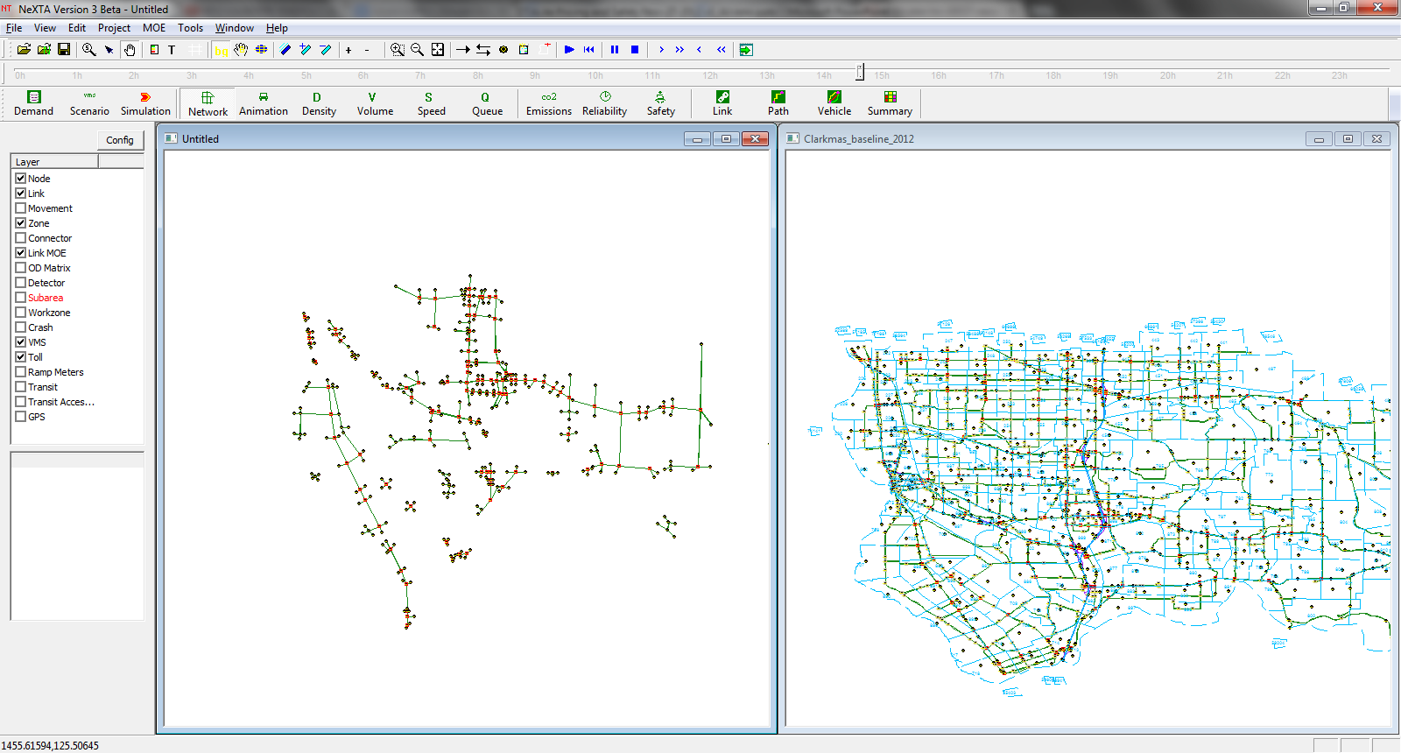
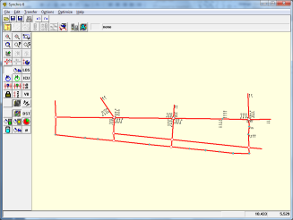
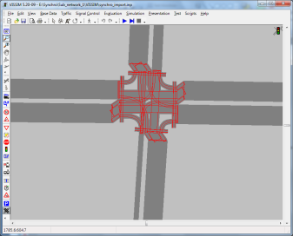
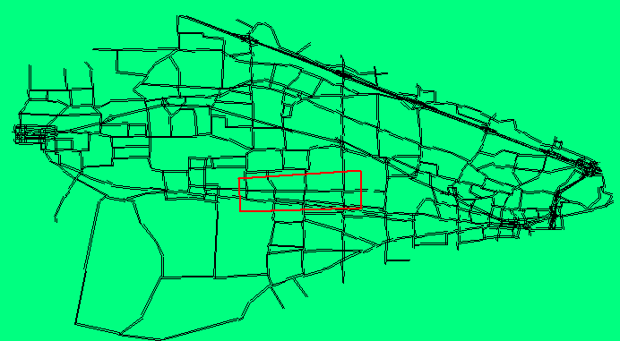
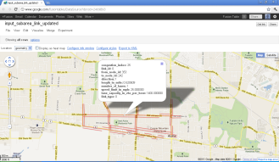

Slide 20
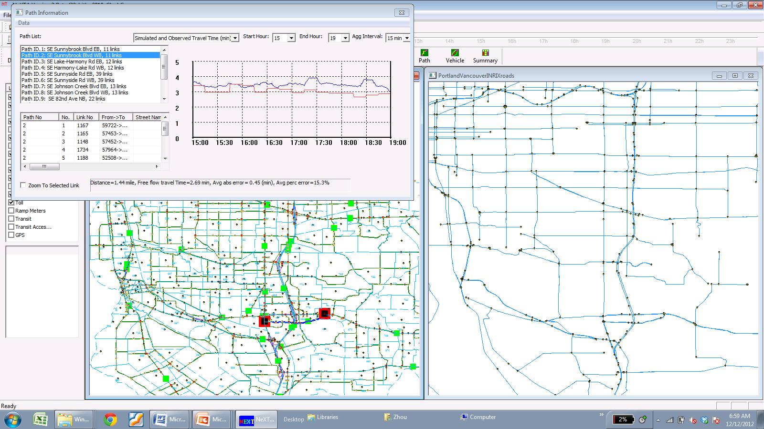
Connection with Traffic Sensor Data
Import TMC GIS data directly to NEXTA
Match TMC links with planning links using two layers
Fetch speed data from Inrix layer to AMS data bub
Compare the observed vs simulated results
Simulated vs Observed Path Travel Time
Inrix Speed Data with TMC Codes
MPO Planning Data

Slide 21
1.1 Project Objective and Motivations
Project Objective
Enhance DTALite to provide a rigorous and computationally efficient tool to evaluate road pricing and crash-reduction strategies
The enhanced tool will enable practitioners to:
Assess corridor and network-wide effects
Conduct numerous alternatives analyses
Evaluate recurring and non-recurring congestion
Calculate performance measures that can be applied in investment-level planning and decision making
Notes:
The project objective was to enhance DTALite by providing a rigorous and computationally-efficient tool for evaluating road pricing and crash reduction strategies. The end goal was to enable practitioners to assess corridor and network-wide effects, leverage DTALite’s computational efficiency to conduct numerous alternatives analyses, evaluate recurring and non-recurring congestion, and calculate performance measures which can be applied in investment-level planning and decision making.

Slide 22
Motivations
1.1 Project Objective and Motivations
Existing technical barriers (based on DTA user survey, TRB network modeling committee, 2009)
- Require too many input data: 47%
- Take too long to run: 35%
- Model is unclear: 35%
Our goals
- Simplified data input from static traffic assignment
- Use parallel computing capability, simplified routing and
simulation
- Open-source Visualization: Seeing is believing
- Excel Tools: Start from basics

Slide 23
1.2 What NeXTA/DTALite Can Do
Open-source traffic simulation/modeling Data Hub
(1) Connection with signal optimization (Synchro) or microscopic simulation (VISSIM)
(2) Integrated simulated and measured data management tools
Large-scale dynamic traffic assignment
(1) Typical network size: 2000 zones, 20K links,1-2 Million vehicles
Network scenario analysis
(1) Road pricing application: Consider time-dependent toll, Heterogeneous Value of times
(2) Emission study: Fast simulation for emission analysis (with MOVES Lite)
(3) Safety planning: Predict annual crash rates based on link type and traffic volume

Slide 24
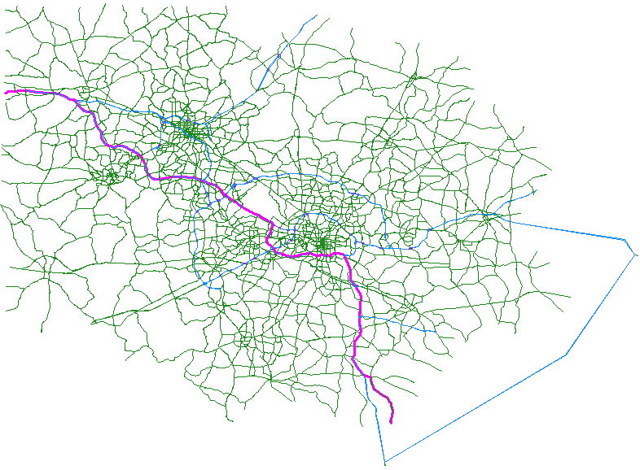
1) Fast Simulation
1.2 What NeXTA/DTALite Can Do
A rigorous and computationally efficient tool to evaluate numerous alternatives analyses
Network Statistics
Triangle Corridor Network (NC, USA)
Zones = 2,389
Nodes = 9,528
Links = 20,258
Signals = 1,914
AM Trips = 1,064,703
Households = 490,000
2 min. 45 sec. / iteration
1hour for 20 iterations
Computer System Specification:
CPU: Intel i7-2960XM @ 2.70 GHz *8
Memory: 16.0 GB
System Type: 64-bit Windows 7

Slide 25
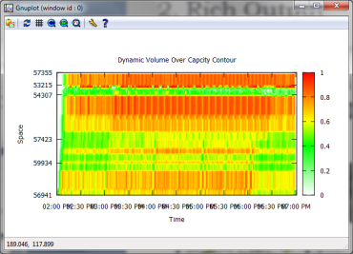
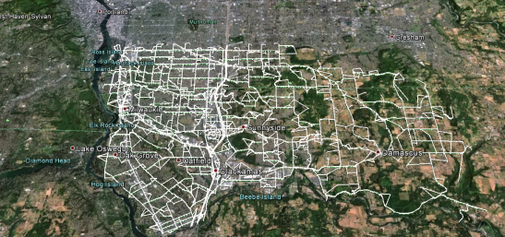
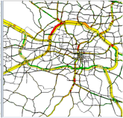
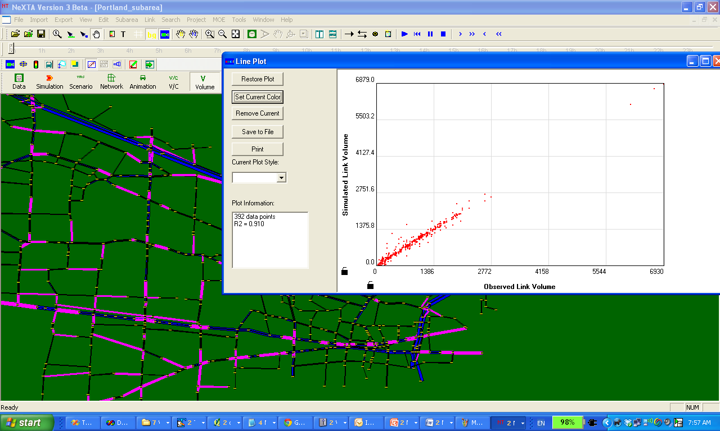
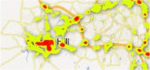
1.2 What NeXTA/DTALite Can Do
2) Rich Output
Other Visualization
Corridor-level VOC contour
Simulation vs. Observation Comparison
Google Earth/Maps
NeXTA
Large-scale Dynamic Traffic Assignment & Simulator

Slide 26
1.2 What NeXTA/DTALite Can Do
3) Integrated Modeling Practice
Current Practice Ad Hoc
With NeXTA Data Hub Systematic
Field Data
Land Use, Safety & Emissions Models
HCM & Signal Timing Models
Micro-simulation Models
Dynamic Traffic Assignment Models
Travel Demand Forecasting Models
Data Hub
Field Data
Land Use, Safety & Emissions Models
HCM & Signal Timing Models
Micro-simulation Models
Dynamic Traffic Assignment Models
Travel Demand Forecasting Models
NeXTA Data Hub

Slide 27
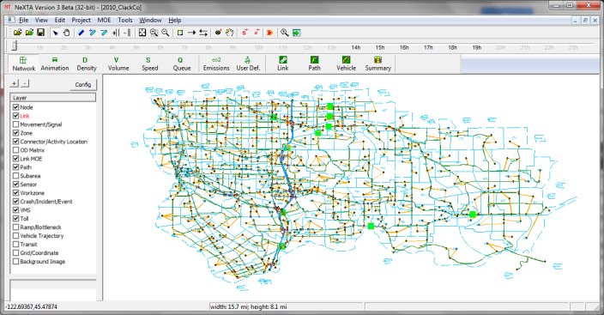
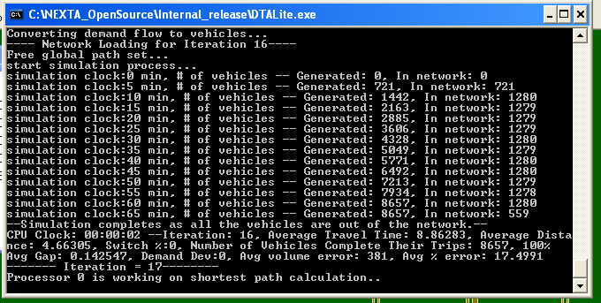
1.3 Open-source Free Software Package
NEXTA: front-end GUI (C++)
Version 2: GUI for TRANSIMS and DYNASMART
Version 3: GNU Open-source data hub
Import
Other regional planning models (TransCAD, VISSUM, Cube)
GIS shape files (household data without node layer)
Traffic volume, speed, GPS data, Google Public Transit Feed
Export
Google Earth, Google fusion tables
Prepare network and signal data for
Synchro and VISSIM (through QEM)
DTALite: Open-source computational engine (C++)
Light-weight and agent-based DTA
Built-in OD demand matrix estimation (ODME) program

Slide 28
Useful Materials
DTALite Software Release
https://github.com/xzhou99/dtalite_software_release
NeXTA/DTALite Training Materials
https://github.com/xzhou99/learning-transportation/tree/master/lessons
DTALite Source Codes
https://github.com/xzhou99/dtalite_beta_test

Slide 29
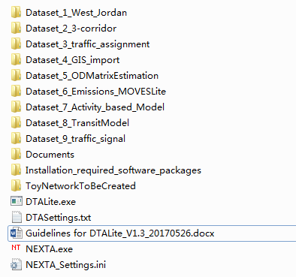
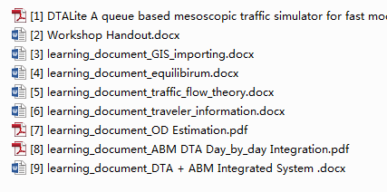
Useful Materials
Installation required software packages
Datasets and Learning documents
User Guide

Slide 30
Module 2 Introduction to DTA modelling principles
2.1 Dynamic Traffic Assignment Modelling Framework
2.2 Agent-based Routing
2.3 VOT Distribution
2.4 Multiple Traffic Simulation Models

Slide 31
2.1 DTA Modelling Framework
Notes:
In general, the traffic simulation assigns vehicles to different paths based upon link travel time. The physical process of moving vehicles works in a two-step process. First, a vehicle is moved across a link during the link pass, and then moved between links at the node during the node pass. Link travel times from the traffic simulator are fed to the shortest path model for path selection. The new paths are then fed back into the traffic simulator in the next iteration.

Slide 32
2.2 Agent-based Routing
Common Assignment Methods
(1) Traffic Analysis Zone (TAZ)-based
From zone centroid to zone centroid
The same value of time for each type of vehicles
(2) Agent-based
From activity location to activity location
Each vehicle has its own value of time, value of information
Important for road tolling analysis, traveler information provision study

Slide 33
2.2 Agent-based Routing
Routing performed for each individual agent
Each agent has multiple dimensions of travel decisions
Origin, destination, departure time, path
Demand class (LOV, HOV, truck) or (HBW, HBO, NHB)
Information class (Historical, Pre-trip, En-route)

Slide 34
2.2 Agent-based Routing
Individual generalized cost function
Can consider multiple factors
Value of time, Value of reliability, Value of safety
Perform routing algorithm individually for each vehicle/agent
Can adjust origin/destination/departure time/path at each iteration (day)
$$Cost=Travel Time∗VOT+Toll$$

Slide 35
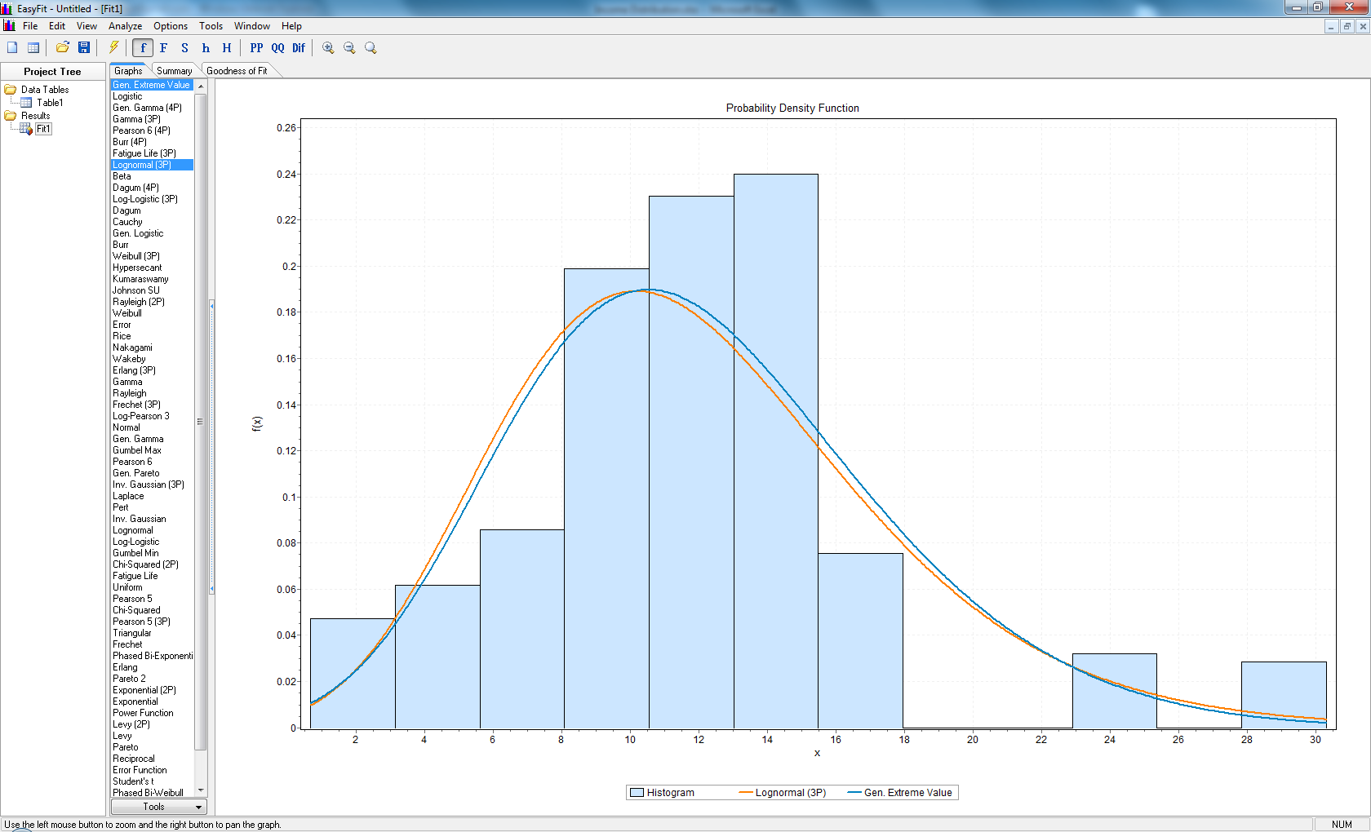
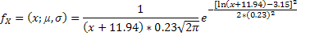
2.3 VOT Distribution
Assumption:
VOT : 50% of hourly rate (Concas and Kolpakov, 2009)
Best fit: Gen. Extreme Value (Orange)
Distribution will be used in DTALite: Lognormal (Blue).
Average VOT: 12 $/hour.

Slide 36
2.4 Multiple Traffic Simulation Models
BPR travel time functions
Point queue (relaxed storage constraints)
Spatial queue (similar to DYNASMART-P model)
Newell’s model (similar to Cell Transmission Model)
Shockwave propagation

Slide 37
2.4 Multiple Traffic Simulation Models
Newell’s simplified kinematic wave model
Outflow capacity
Inflow capacity
Storage capacity
Exit Queue
Entrance List
Inflow Capacity
Outflow Capacity
Storage Capacity

Slide 38
2.4 Multiple Traffic Simulation Models
Newell’s simplified kinematic wave model
Triangular flow-density relationship
Free flow speed, jam density, backward wave speed

Slide 39
2.4 MultipleTraffic Simulation Models
Queue propagation
Inflow capacity = outflow capacity
Inflow Capacity
Outflow Capacity

Slide 40
2.4 Multiple Traffic Simulation Models
Node transfer
Node Transfer
Node
Check Outflow Capacity
Check Inflow Capacity
Check Storage Capacity
Notes:
Going into more specifics, let’s take a closer look at the link pass and node pass. The capacity constraints are enforced at both ends of each link. At the beginning of the link, the entrance list keeps track of vehicles entering the link, enforcing the inflow capacity constraint. During the link pass, the vehicles are moved between the entrance list and the exit queue. The exit queue keeps track of vehicles waiting to leave the link, enforcing the outflow capacity constraint. Vehicles are then moved between the exit queue and the entrance list of the next link during the node.

Slide 41
2.4 Multiple Traffic Simulation Models
Merge Models
Distribute inflow capacity to upstream links
Lane & demand-based methods
80%
Node
Available Inflow Capacity
20%

Slide 42
2.4 Multiple Traffic Simulation Models
Diverge Models
Different conditions by lane
First-In-First-Out (FIFO) constraint
Relaxation to prevent extreme bottlenecks
Node

Slide 43
2.4 Multiple Traffic Simulation Models
Signalized Intersections
Effective green time, saturation flow rate, movement-based capacity
Relaxed inflow constraints

Slide 44
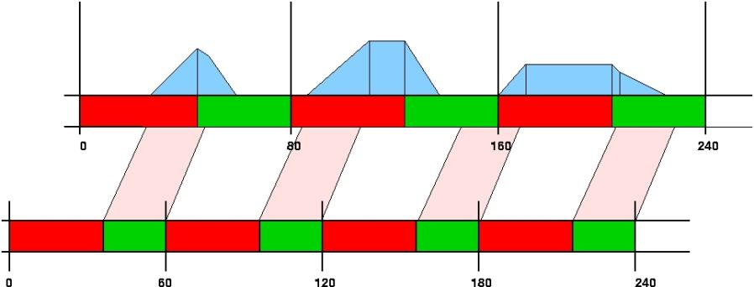
2.4 Multiple Traffic Simulation Models
Signal Timing & Hourly Capacity
Input: Average hourly capacity, cycle time, offset at node
Output: Effective green time per cycle(capacity/saturation flow rates)

Slide 45
Module 3 Visualization Features in NeXTA
3.1 Basic GUI features
3.2 View/Edit data files in NEXTA’s “project” menu
3.3 Integration with assignment model
3.4 Advanced visualization functions of NEXTA
3.5 MOE related display
3.6 Data exporting to Google Earth /GIS package

Slide 46
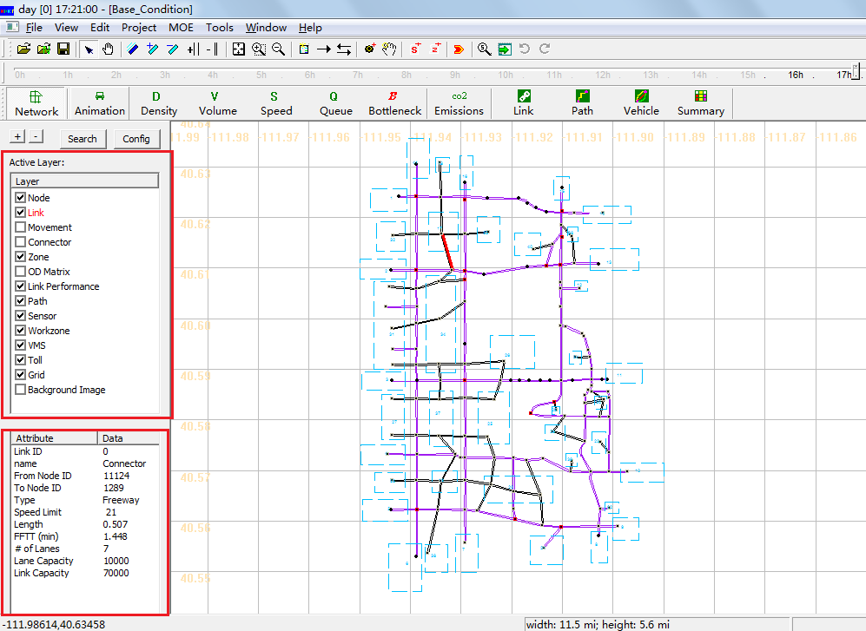
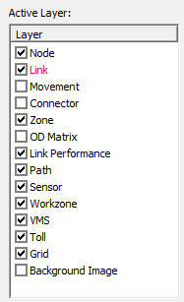
3.1 Basic GUI features
Turn on and off GIS layers; Move around, select node and links; Toolbars for editing networks
Open project folder (CSV file format)

Slide 47
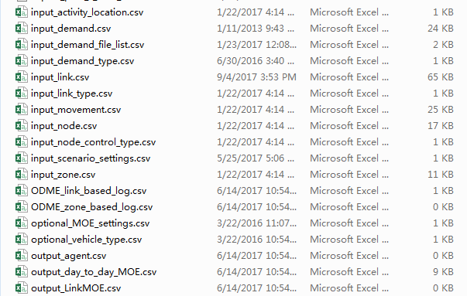
3.1 Basic GUI features
Turn on and off GIS layers; Move around, select node and links; Toolbars for editing networks
Open project folder (CSV file format)

Slide 48
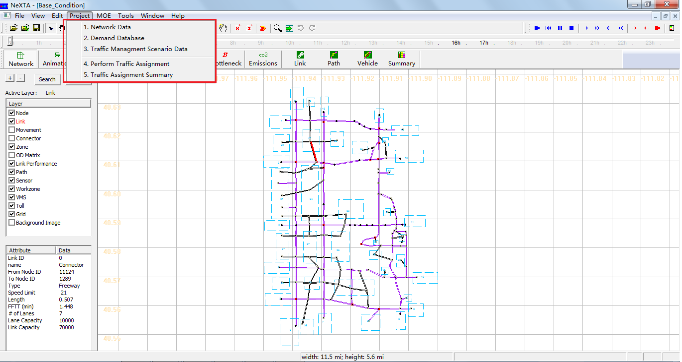
3.2 View/Edit data files in “project” menu
Node/link/zone/activity location
Demand meta database
Scenario files

Slide 49
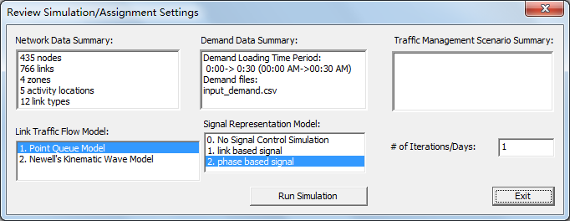
3.3 Integration with assignment model
Traffic flow model
Traffic Assignment method

Slide 50
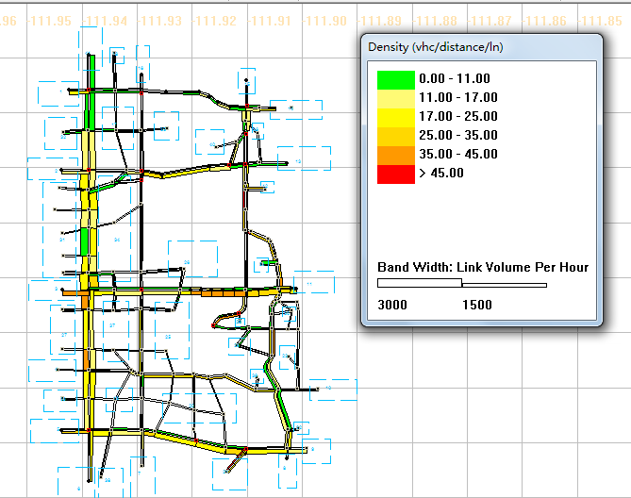
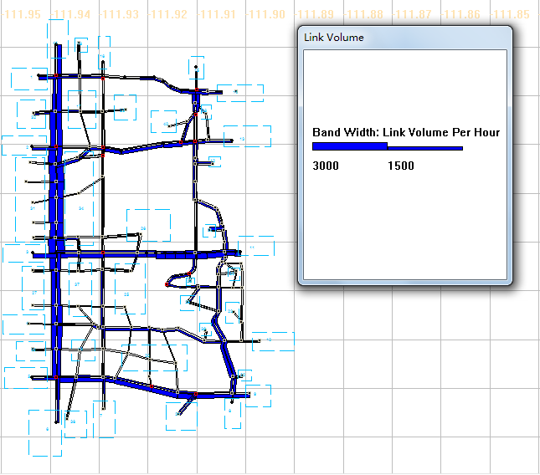
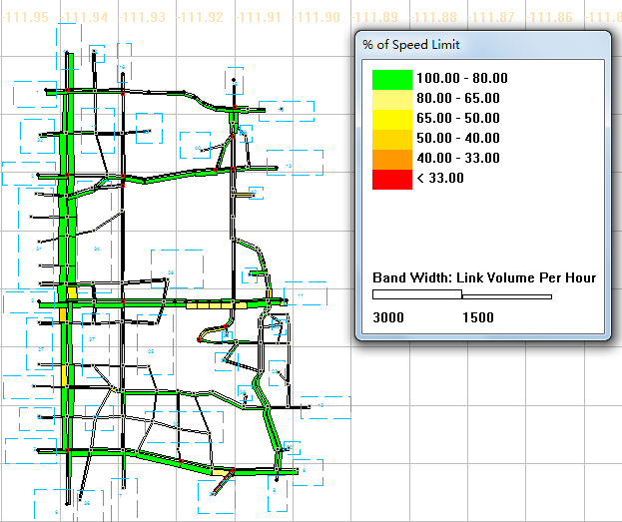
3.4 Advanced visualization functions of NeXTA
24-hour Time control/Clock bar
Volume (bandwidth), density, speed
Animation and queue: (turn off node layer and bandwidth)

Slide 51
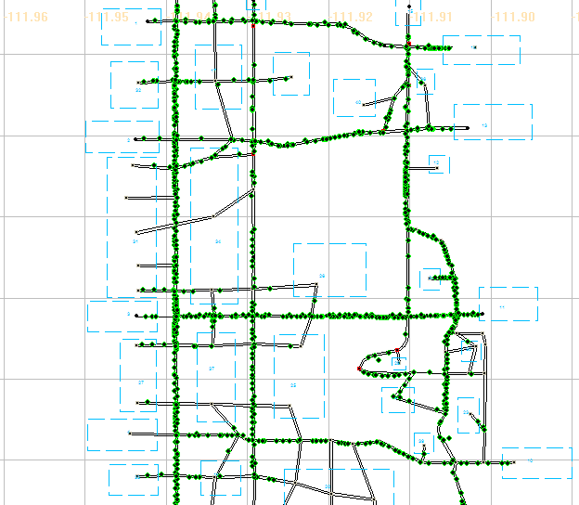
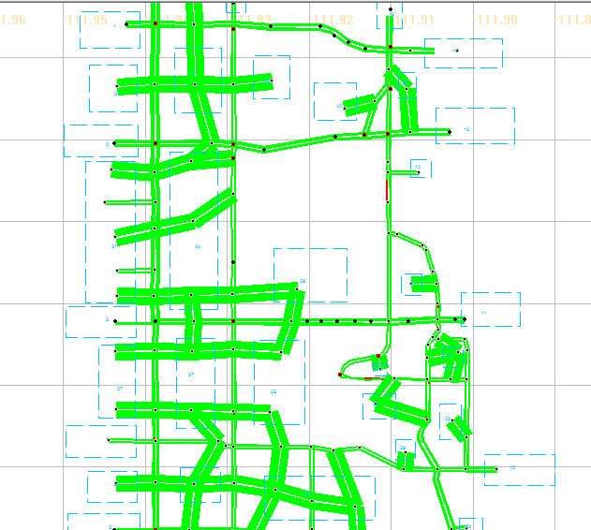
3.4 Advanced visualization functions of NeXTA
24-hour Time control/Clock bar
Volume (bandwidth), density, speed
Animation and queue: (turn off node layer and bandwidth)

Slide 52
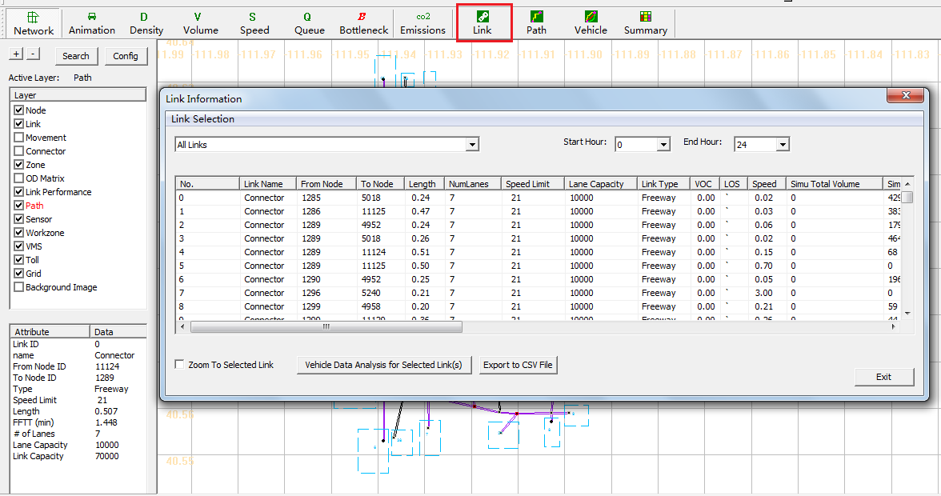
3.5 MOE related display
Link-related display
Path-related display
Vehicle and Summary Charts

Slide 53
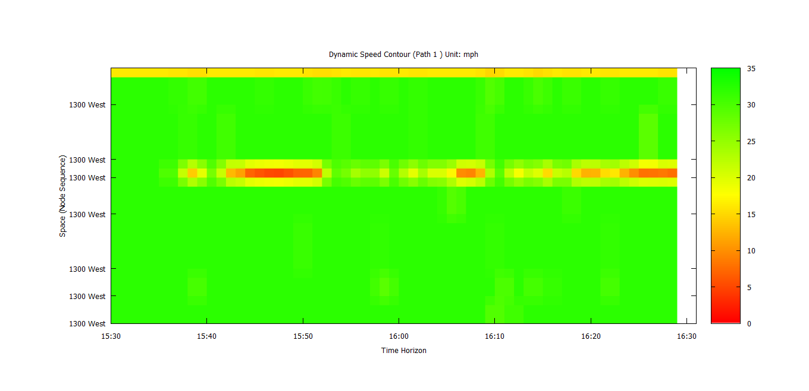
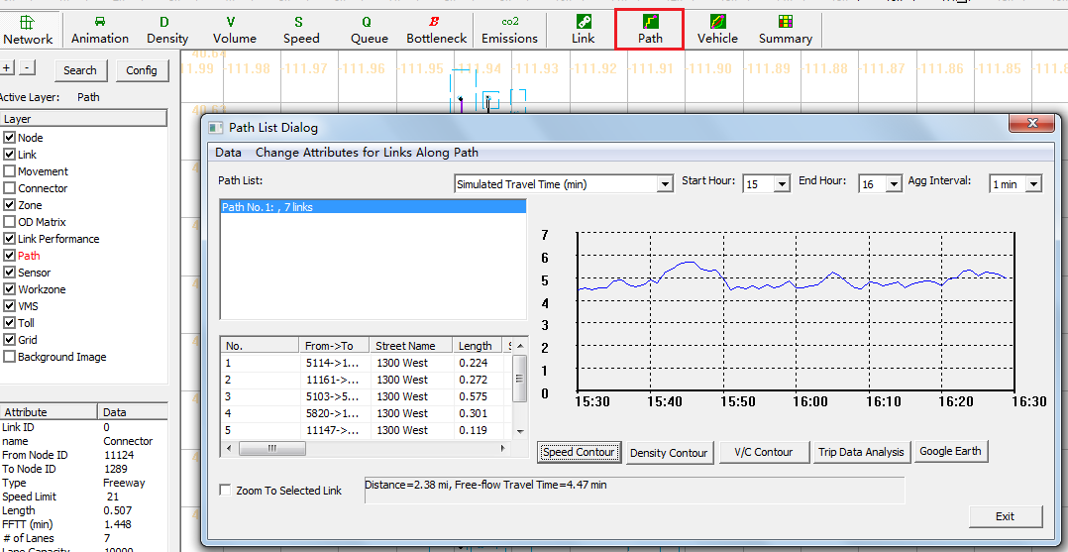
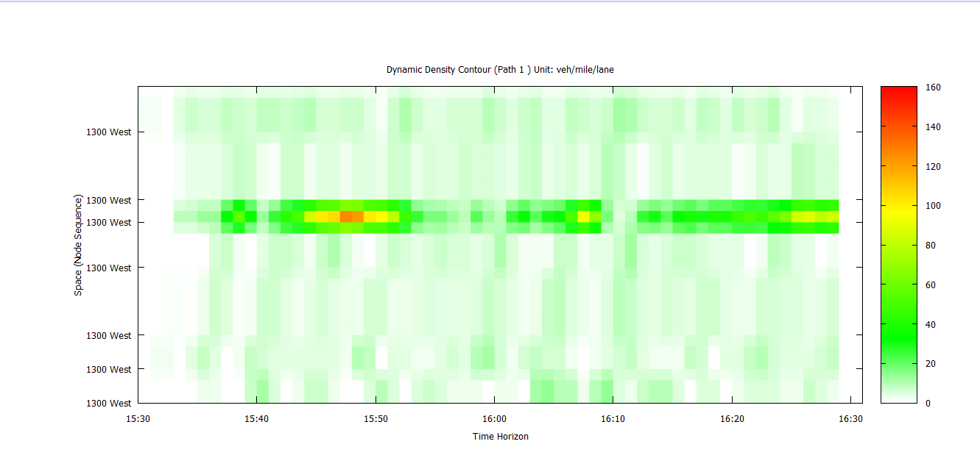
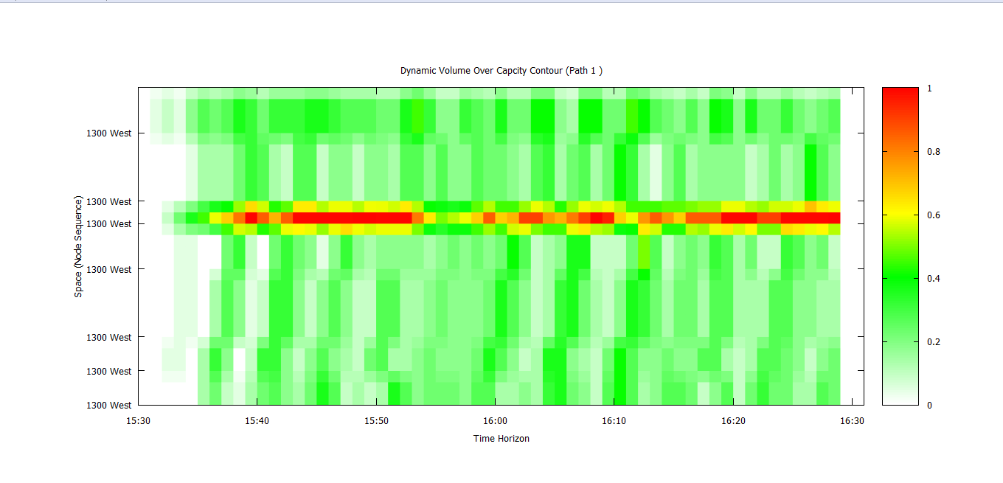
3.5 MOE related display
Link-related display
Path-related display
Vehicle and Summary Charts

Slide 54
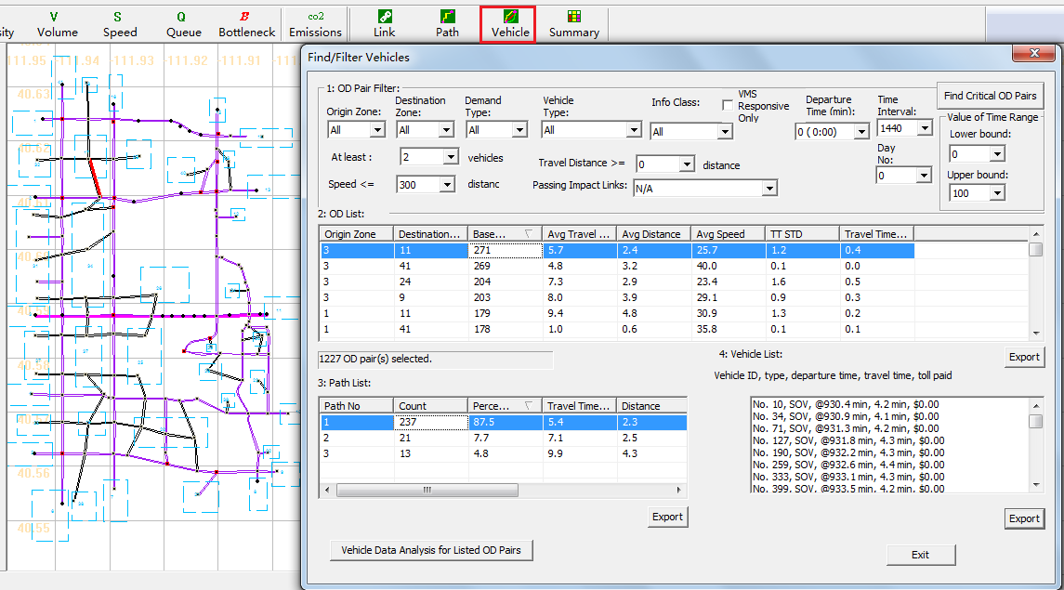
3.5 MOE related display
Link-related display
Path-related display
Vehicle and Summary Charts

Slide 55
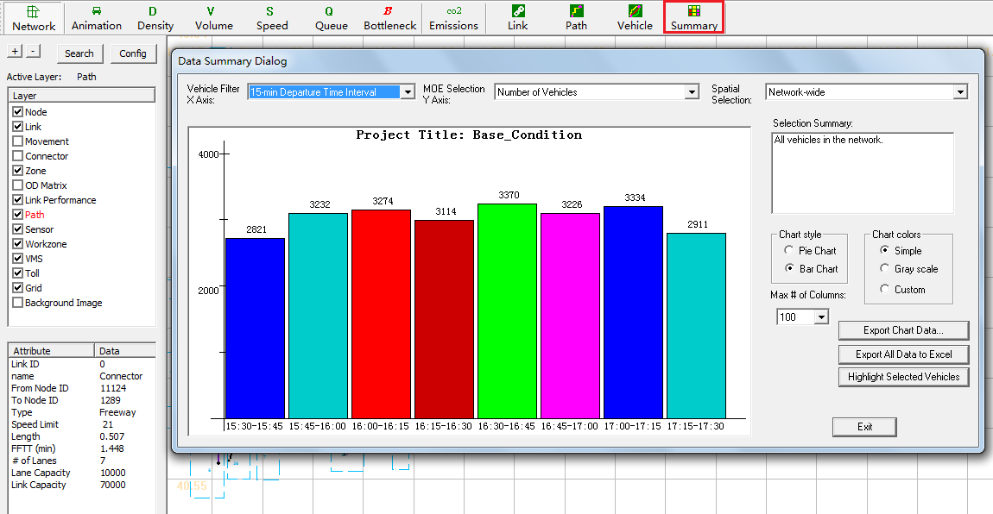
3.5 MOE-related display
Link-related display
Path-related display
Vehicle and Summary Charts

Slide 56
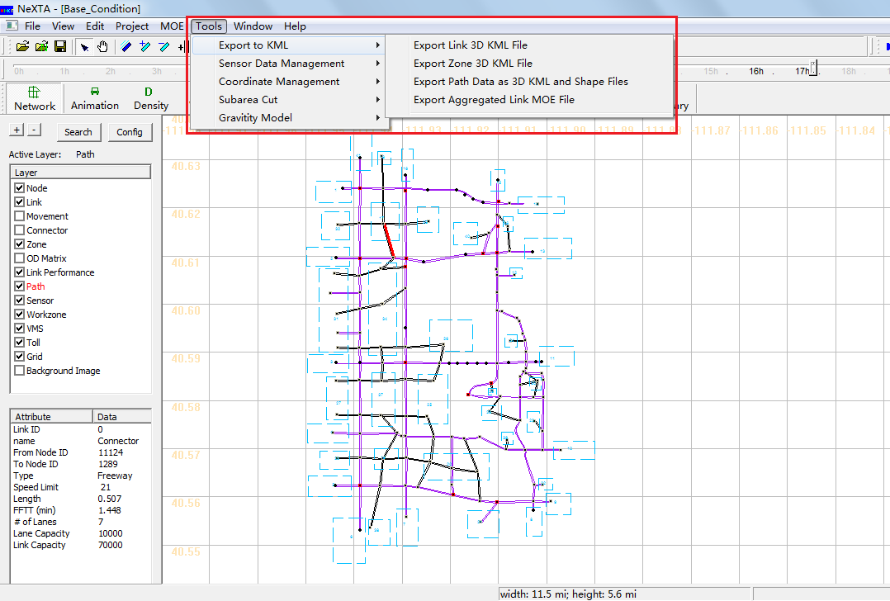
3.6 Export Data to Google Earth/GIS package
2D KML, 3D KML, GIS shape files
Google Earth visualization
Zone level display: adjust height/color

Slide 57
Module 4 Introduction to Workshop Exercises
4.1 Data Preparation for Building A Regional Traffic Network
4.2 Clackamas Network Modeling(Calibration)

Slide 58
4.1 Data Preparation for Building A Regional Traffic Network
Data Block | File Name
GIS Shape Files | 1a: node shape file
 | 1b: link shape file
 | 1c: zone shape file
GIS Importing Setting Files | 2: input_GIS_setting.csv
Advanced Definition Files | 3a: input_node_control_type.csv
 | 3b: input_link_type.csv
 | 3c: input_demand_type.csv
 | 3d: optional_vehicle_emission_rate.csv
Demand Files | 4.Demand files
Simulation Configuration Files | 5: input_demand_file_list.csv
 | 6. input_scenario_settings.csv
D: Scenario Files | 7a: sensor_count.csv
 | 7b: sensor_speed.csv
 | 8: Scenario_Work_Zone.csv
 | 9: Scenario_Dynamic_Message_Sign.csv
 | 10: Scenario_Link_Based_Toll.csv

Slide 59
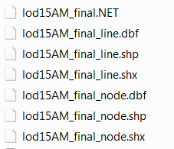
Step 1: Prepare Required Shape files
4.1 Data Preparation for Building A Regional Traffic Network
node shape file (1a)
link shape file (1b)
zone shape file (1c) -- optional
e.g. given shape files for the Atlanta network:
- lod15AM_final_node.shp:
provide node ID and coordinate values;
- lod15AM_final_line.shp:
provide from node id, to node id, length of links,
link type, number of lanes of link, ect.

Slide 60
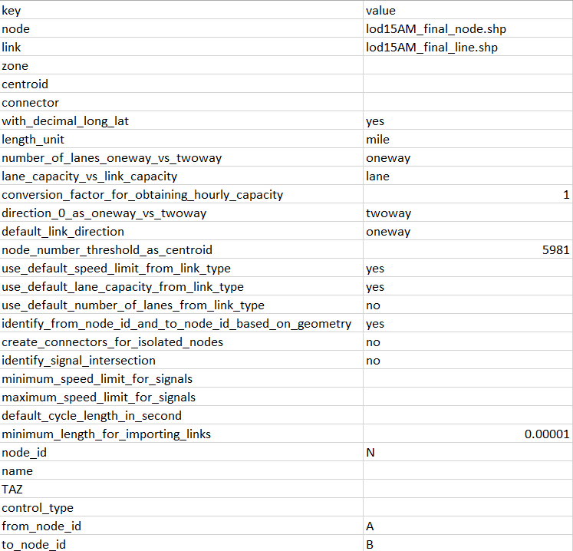
4.1 Data Preparation for Building A Regional Traffic Network
Step 2: Extract GIS information from shape files –importing configuration
The hub between shape files and NeXTA network data is import_GIS_settings.csv.(2)
How to do the settings for import_GIS_settings.csv can be found at the learning document in “DTALite-NEXTA-Software-Package”
[3] learning_document_GIS_importing.docx

Slide 61
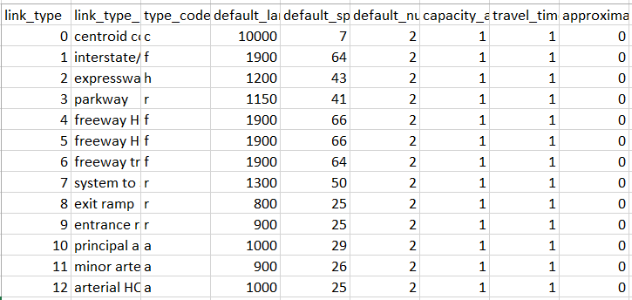
4.1 Data Preparation for Building A Regional Traffic Network
Step 3: Meta data files for building the network
input_link_type.csv (3b)
input_node_control_type.csv(3a) -- optional

Slide 62
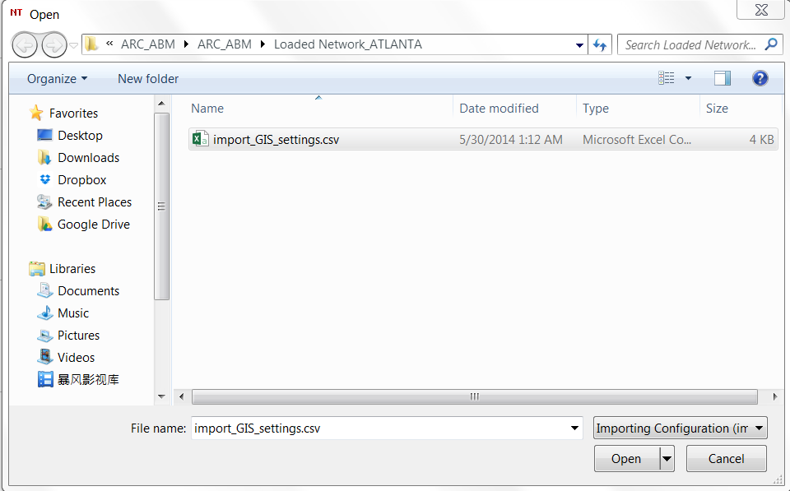
4.1 Data Preparation for Building A Regional Traffic Network
Step 4: Import GIS network to NeXTA
Open NEXTA_GIS_Import.exe that is the only one program to generate traffic network;
Click “File” ->“Import GIS Data Set”->“Next”. It will display the following dialogue.

Slide 63
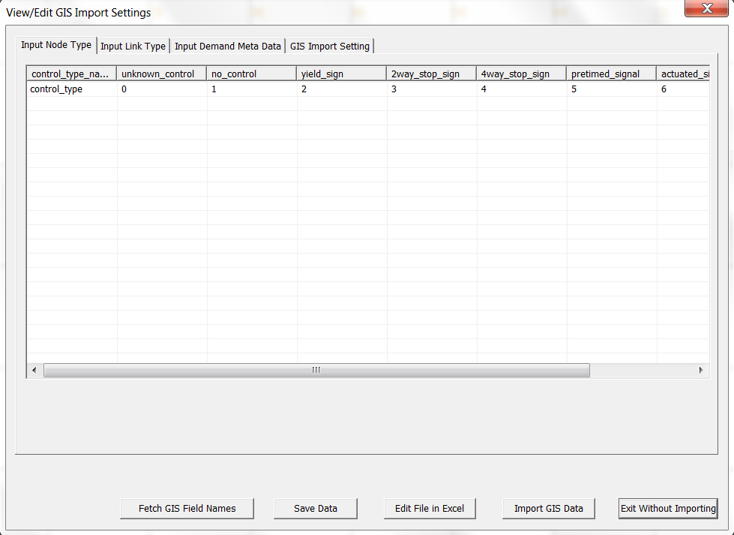
4.1 Data Preparation for Building A Regional Traffic Network
Step 4: Import GIS network to NeXTA
Choose the import_GIS_setting.csv file and open it. It will display the right interface: those four csv files can be checked here.

Slide 64
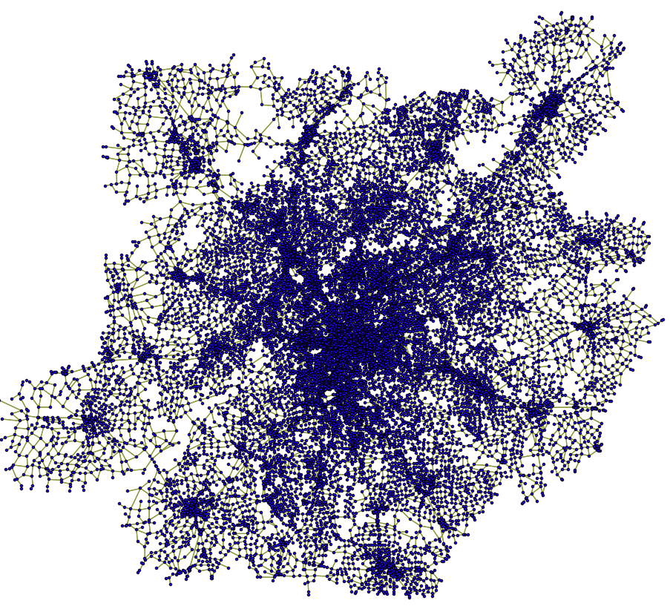
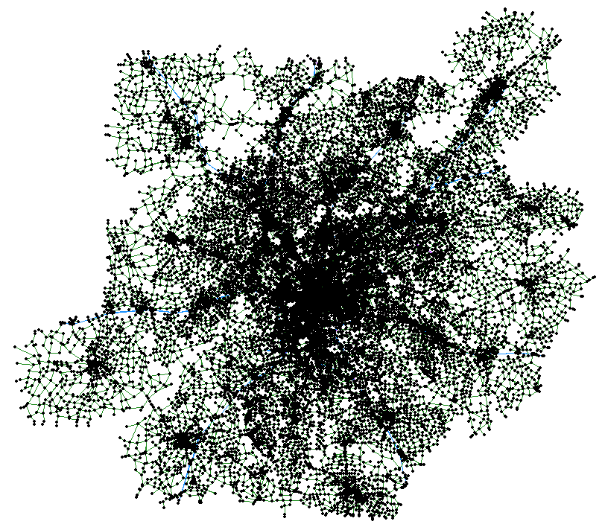
4.1 Data Preparation for Building A Regional Traffic Network
Step 4: Import GIS network to NeXTA
Click “Import GIS Data” button. And the network will be generated.
GIS Shape files
NeXTA

Slide 65
4.1 Data Preparation for Building A Regional Traffic Network
Step 5: Prepare Demand files
Demand file (4) is the source of dynamic traffic assignment. Generally, it is provided by users. And all types of demand should be defined in Input_demand_type(3c)
NeXTA can accommodate various demand formats:
column format from VISUM,
matrix format,
full matrix format,
Dynasmart format,
agent file,
and so on.

Slide 66
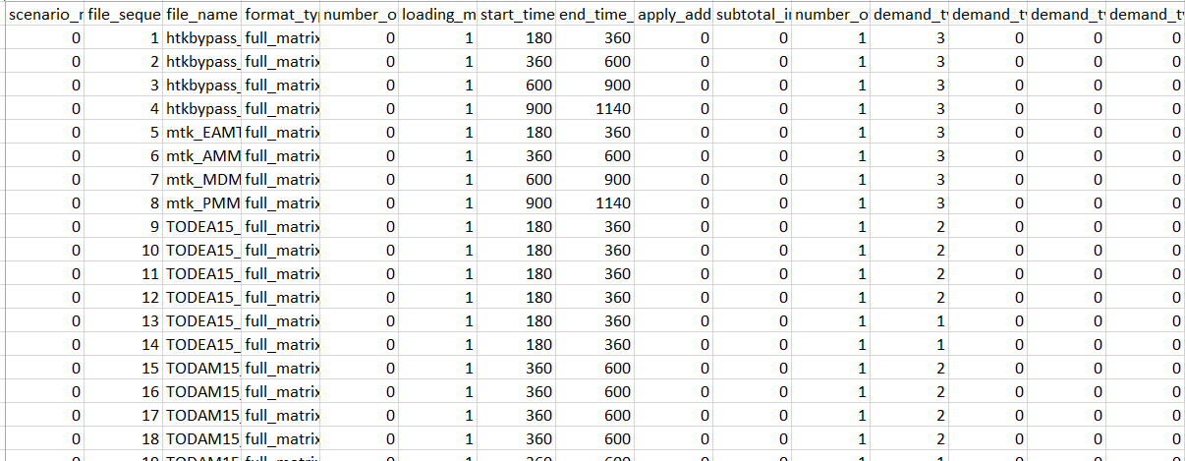
4.1 Data Preparation for Building A Regional Traffic Network
Step 5: Prepare Demand files
Input_demand_file_list.csv(5) is used to define the characteristics of demand data (4).

Slide 67
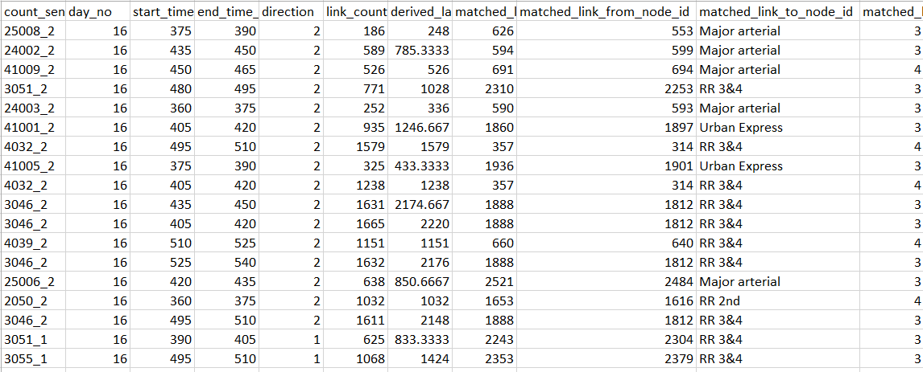
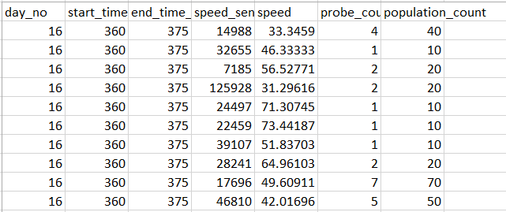
4.1 Data Preparation for Building A Regional Traffic Network
Step 6: Data required for OD Demand calibration
sensor_count.csv (7a)
link_count , matched_link_from_node_id, matched_link_to_node_id;
sensor_speed.csv(7b)
speed_sensor_id , speed, population_count;
Sensor_count.csv
sensor_speed.csv

Slide 68

4.1 Data Preparation for Building A Regional Traffic Network
Step 7: Work zone evaluation
The setting file for work zone simulation is
Scenario_Work_Zone.csv (8)
Scenario_Work_Zone.csv

Slide 69

4.1 Data Preparation for Building A Regional Traffic Network
Step 8: VMS evaluation
Scenario_Dynamic_Message_Sign.csv(9) is used to define the location and characteristics of variable message signs in the simulation
Scenario_Message_Sign.csv

Slide 70

4.1 Data Preparation for Building A Regional Traffic Network
Step 9: Tolling evaluation
Scenario_Link_Based_Toll.csv (10)
Since the toll for different demand types is represented by money, the data Value of Time in input_demand_type.csv is important.
Scenario_Link_Based_Toll.csv

Slide 71

4.1 Data Preparation for Building A Regional Traffic Network
Step 10: Emission evaluation(9a)
optional_vehicle_emission_rate.csv (3d)
optional_vehicle_emission_rate.csv

Slide 72

4.1 Data Preparation for Building A Regional Traffic Network
Step 11: Run Simulation
Input_scenario_setting.csv (6)
Input_scenario_setting.csv

Slide 73

4.2 Clackamas Network Modeling(Calibration)
Converting from Macroscopioc Model to Mesoscopic Model
Directly import important network attributes: Capacity, speed, number of lanes, etc.
First Simulation Run:
Wide-scale Gridlock (Red)
Notes:
In our first example, let’s take a look at a simple macroscopic model that was converted for use with our mesoscopic model. We directly imported the network attributes, including capacity, speed, and the number of lanes. This creates an underlying assumption that the macroscopic capacities are compatible with the capacities in our mesoscopic model. In effect, we are using the macroscopic capacities for the capacity constraints in the DTA model. In our first simulation run, with very few adjustments, we found wide-scale gridlock, shown in red here. As you can see, they were appropriate in some locations in this model, mostly on freeways, but not so much in others. In this case, ramp capacities were causing significant queuing, and were creating more queuing in the arterial street network.

Slide 74

4.2 Clackamas Network Modeling(Calibration)
Second Attempt
Increased ramp outflow capacity
- Still experiencing significant queuing

Slide 75
4.2 Clackamas Network Modeling(Calibration)
Inflow/Storage Capacity?

Slide 76

4.2 Clackamas Network Modeling(Calibration)
Geometry Details
Two-lane ramp, coded with one lane
- Reasonable outflow capacity
- Potential issues
Underestimated inflow capacity
- Underestimated storage capacity
Notes:
In this example, we find an interesting two-lane on-ramp entering the freeway. It begins as a two-lane facility, and enters the freeway as a one-lane facility. The ramp link was coded with one lane, which accurately represents the outflow capacity at the end of the link. However, since we’re missing a lane over a portion of the link, we’ve underestimated both the inflow capacity and storage capacity.

Slide 77
4.2 Clackamas Network Modeling(Calibration)
Traffic Flow Model Sensitivity

Slide 78

4.2 Clackamas Network Modeling(Calibration)
Third Attempt
Reset outflow capacity, adjusted inflow & storage capacity

Slide 79

4.2 Clackamas Network Modeling(Calibration)
Combined Modifications
Combination of adjusting outflow and storage capacity appears more reasonable

Slide 80
4.2 Clackamas Network Modeling(Calibration)
Recommended Diagnostic Procedures
Macroscopic capacity may not be appropriate for mesoscopic capacity constraints
Understand the traffic flow model
Understand limitations, special cases
Adjust capacity before OD demand, path flow
Start with fewer capacity constraints to remove possible unrealistic bottlenecks
Point queue → Spatial queue → Shock wave → Speed-density relationships

Slide 81
Thank You!
Questions, Comments, and Suggestions are Welcome.
Please Contact:
Xuesong Zhou, Ph.D. Arizona State University
Tempe, AZ 85287
Email: xzhou74@asu.edu

Slide 82
Open-Source Dynamic Traffic Assignment Package
DTALite/NEXTA
(September, 2017)
Xuesong Zhou
xzhou99@gmail.com
xzhou74@asu.edu

Slide 83
Outline
Module 5: Traffic Flow Theory
Module 6: OD Matrix Estimation
Module 7: Signalized Intersections Modeling
Module 8: Vehicle Routing C++ Code
Notes:
As I just mentioned, the webinar is divided into four parts, referring to four separate videos which make up this recorded session. This is the first session, where we’ll introduce you to DTALite and NeXTA, and provide an overview of our project development so far.

Slide 84

Synchronized display in NeXTA

Slide 85
Vehicle Analysis Dialog

Slide 86
Module 3: Modeling Approach

Slide 87

Module 5 Traffic Flow Theory
Traffic Congestion Propagation: Understanding Theoretical Basics of Dynamic Traffic Network Assignment and Simulation
Contributing Author: Jiangtao Liu
https://scholar.google.com/citations?user=VLP4r4MAAAAJ&hl=en

Slide 88


Learning Objectives
5.1 Traffic Congestion Propagation
(1) Understand major input and
output data for a dynamic network
loading program;
(2) Identify bottlenecks and model congestion propagation;
(3) Calculate traffic states through different computational approaches.
Data Set
https://github.com/xzhou99/learning-transportation/tree/master/Lessons/Lesson%202/Data%20Set

Slide 89

Sample Case: 3-corridor Network
5.1 Traffic Congestion Propagation

Slide 90


Slide 91


Slide 92


Slide 93


Slide 94


Slide 95


Slide 96


5.1 Traffic Congestion Propagation
Case 1: demand = supply (multiplier = 1.0)
Graphical Method
U: interface between two different traffic states.
State O: there is no traffic flow
State A: the demand traffic enter the link 8->9
State C: the steady traffic state of link 9->10
The flow-density relationship for different states of links

Slide 97


Slide 98
Step 1: Check the value of traffic demand
5.1 Traffic Congestion Propagation
Case 1: demand = supply (multiplier = 1.0)
When Demand multiplier is 1.0, the hourly OD demand is 0.5*7200*1 = 3600 vehicles.
The limit capacity of the path 1 is 3600, so now the demand is equal to the path capacity.
The traffic demand from origin zone 1 to destination zone 2 is 7200 vehicles in two hours. You can check value of traffic demand from “input_demand.csv” in the project folder.

Slide 99

5.1 Traffic Congestion Propagation
Case 1: demand = supply (multiplier = 1.0)
Step 2: Setup simulation settings
Please use the following simulation settings shown in the flowing figure, and run simulation
Link Traffic Flow Model: “Newell’s Kinematic Wave Model”
# of Iterations/Days: 1

Slide 100
5.1 Traffic Congestion Propagation
Case 1: demand = supply (multiplier = 1.0)
Step 3: View the result of simulation and analyze traffic states
View the simulation result: “Total Volume over Capacity Ratio” in the file output_summary.csv
from_node_id | to_node_id | type_code | link_type | link_length | start_time_in_min | end_time_in_min | total_link_volume | lane_capacity_in_vhc_per_hour | link_capacity_in_vhc_per_hour | volume_over_capacity_ratio
1 | 3 | f | Freeway | 1 | 420 | 540 | 7200 | 1900 | 5700 | 0.6316
3 | 4 | f | Freeway | 1 | 420 | 540 | 7200 | 1800 | 5400 | 0.6667
4 | 5 | f | Freeway | 1 | 420 | 540 | 7200 | 1800 | 5400 | 0.6667
5 | 6 | f | Freeway | 1 | 420 | 540 | 7200 | 1800 | 5400 | 0.6667
6 | 7 | f | Freeway | 1 | 420 | 540 | 7200 | 1800 | 5400 | 0.6667
7 | 8 | f | Freeway | 1 | 420 | 540 | 7200 | 1800 | 5400 | 0.6667
8 | 9 | f | Freeway | 1 | 420 | 540 | 7200 | 1800 | 5400 | 0.6667
10 | 11 | f | Freeway | 1 | 420 | 540 | 7200 | 1800 | 3600 | 1
11 | 12 | f | Freeway | 1 | 420 | 540 | 7200 | 1800 | 5400 | 0.6667
9 | 10 | f | Freeway | 1 | 420 | 540 | 7200 | 1800 | 3600 | 1
12 | 2 | f | Freeway | 1 | 420 | 540 | 7200 | 1800 | 7200 | 0.5

Slide 101

5.1 Traffic Congestion Propagation
Case 1: demand = supply (multiplier = 1.0)
Step 3: View the traffic states of one path
Choose a path in the network
Click on the “Density Contour”, “Speed Contour”, and “V/C Contour” to analyze the details of this traffic assignment.

Slide 102

5.1 Traffic Congestion Propagation
Case 1: demand = supply (multiplier = 1.0)
Step 3: View the traffic states of one path
Similarly, other analyses can also be displayed easily.
link 9->10 and link 10->11 has a high density, which is consistent with the above “Total Volume over Capacity Ratio”.

Slide 103

5.1 Traffic Congestion Propagation
Case 1: demand = supply (multiplier = 1.0)
Step 4: View link MOE of bottleneck links
Simulated lane volume of link 8->9

Slide 104

5.1 Traffic Congestion Propagation
Case 1: demand = supply (multiplier = 1.0)
Step 4: View link MOE of bottleneck links
Simulated speed of link 8->9

Slide 105

5.1 Traffic Congestion Propagation
Case 1: demand = supply (multiplier = 1.0)
Step 4: View link MOE of bottleneck links
Simulated density of link 8->9

Slide 106

5.1 Traffic Congestion Propagation
Case 1: demand = supply (multiplier = 1.0)
Graphical Method
Vehicles’ trajectory in time-space diagram
Speed
The speed of link 8->9 and link 9->10 is the free flow speed, 60 mph, because the demand is equal to the capacity for the two links.

Slide 107
5.1 Traffic Congestion Propagation
Case 1: demand = supply (multiplier = 1.0)
Graphical Method
Vehicles’ trajectory in time-space diagram
Density
Link 8->9 is always at the state A and link 9->10 is at the state C, so its density is 60 vpmpl(link) for the both links.
Meanwhile, about the density of each lane, link 8->9 is 20 vpmpl(lane) and link 9->10 is 30 vpmpl(lane).

Slide 108
5.1 Traffic Congestion Propagation
Case 1: demand = supply (multiplier = 1.0)
Graphical Method
Vehicles’ trajectory in time-space diagram
Propagation time: N/A

Slide 109
5.1 Traffic Congestion Propagation
Case 2: demand > supply (multiplier = 1.2)
Step 1: Check the value of traffic demand
When the demand multiplier is 1.2, the hourly OD demand is 0.5*7200*1.2 (4320).
The limit capacity of the path 1 is 3600, so now the demand is slightly higher than the path capacity.
As a result, a traffic congestion is formed and further propagated to the upstream corridor.

Slide 110
5.1 Traffic Congestion Propagation
Case 2: demand > supply (multiplier = 1.2)
Step 2: Setup simulation settings
Go to input_demad_file_list.csv
Change the loading multiplier to 1.2 in the excel sheet
Run the simulation for 1 iteration.

Slide 111
5.1 Traffic Congestion Propagation
Case 2: demand > supply (multiplier = 1.2)
Step 3: View link MOE of path 1
traffic congestion starts from link 8->9, and then propagates back to upstream links
Then the traffic jam reaches the starting link 1->3 (without further space to accommodate the congestion), leading to continuously increasing density

Slide 112

5.1 Traffic Congestion Propagation
Case 2: demand > supply (multiplier = 1.2)
Step 4: View link MOE of bottleneck links
Simulated speed of link 8->9

Slide 113

5.1 Traffic Congestion Propagation
Case 2: demand > supply (multiplier = 1.2)
Step 4: View link MOE of bottleneck links
Simulated density of link 8->9

Slide 114
5.1 Traffic Congestion Propagation
Case 2: demand > supply (multiplier = 1.2)
Step 5: Describe traffic speed and density evolutions on links 7->8 and 8->9, Calculate the traffic congestion speed
The speed of link 8->9 changes from 60 mph to 15 mph in the first 20 min, and its density increases from 24 vpmpl to 80 vpmpl.
To calculate traffic congestion propagation speed, we need to measure the propagation time and link length (1 mile)

Slide 115

5.1 Traffic Congestion Propagation
Case 2: demand > supply (multiplier = 1.2)
Step 5: Describe traffic speed and density evolutions on links 7->8 and 8->9, Calculate the traffic congestion speed
Select two links simultaneously, link 8->9 and link 7->8.
Using key combination “ctrl +mouse click”, we can obtain the link MOE plot and then measure the queue propagation time.

Slide 116
5.1 Traffic Congestion Propagation
Case 2: demand > supply (multiplier = 1.2)
Step 5: Describe traffic speed and density evolutions on links 7->8 and 8->9, Calculate the traffic congestion speed
One can also precisely measure the exact propagation time duration using exported link MOE csv file.
When the density (link 8->9) becomes 80, the corresponding time is 441min.
When the density (link 7->8) becomes 80, the corresponding time is 455 min.
Thus, the propagation time duration is 14 min.

Slide 117
5.1 Traffic Congestion Propagation
Case 2: demand > supply (multiplier = 1.2)
Graphical Method
U: interface between two different traffic states.
State O: there is no traffic flow
State A: the demand traffic enter the link 8->9
State B: the steady traffic state of link 8->9
State C: the steady traffic state of link 9->10
The flow-density relationship for different states of links

Slide 118

5.1 Traffic Congestion Propagation
Case 2: demand > supply (multiplier = 1.2)
Graphical Method
Vehicles’ trajectory in time-space diagram
Speed
for link 8->9, at state A, its speed is 60 mph; at state B, due to the limitation of capacity, its speed is 15 mph.
For link 9->10, the vehicles will drive at a speed based on the capacity, state C, whose speed is 60 mph;

Slide 119
5.1 Traffic Congestion Propagation
Case 2: demand > supply (multiplier = 1.2)
Graphical Method
Vehicles’ trajectory in time-space diagram
Density
for link 8->9, at the state A, its density is 72 vpmpl(link). After the propagation time, it is at the state B, whose density is 240 vpmpl(link).
Meanwhile, the link 9->10 is always at the state C, whose density is 60 vpmpl(link).

Slide 120
5.1 Traffic Congestion Propagation
Case 2: demand > supply (multiplier = 1.2)
Graphical Method
Vehicles’ trajectory in time-space diagram
Propagation time: 14 min.

Slide 121
5.1 Traffic Congestion Propagation
Case 3: demand > supply (multiplier = 1.3)
Step 1: Check the value of traffic demand
In this case, the demand OD is still 7200 from 7am to 9am,
the multiplier is 1.3. so now the demand is much higher than the path capacity.
The analysis process is the same as case 2 (0.5*7200*1.3 = 4680 vehicles).

Slide 122
5.1 Traffic Congestion Propagation
Case 3: demand > supply (multiplier = 1.3)
Step 2: Setup simulation settings
Go to input_demad_file_list.csv
Change the loading multiplier to 1.3 in the excel sheet
Run the simulation for 1 iteration.

Slide 123

5.1 Traffic Congestion Propagation
Case 3: demand > supply (multiplier = 1.3)
Step 3: View link MOE of bottleneck links
Simulated speed of link 8->9

Slide 124

5.1 Traffic Congestion Propagation
Case 3: demand > supply (multiplier = 1.3)
Step 3: View link MOE of bottleneck links
Simulated density of link 8->9

Slide 125

5.1 Traffic Congestion Propagation
Case 3: demand > supply (multiplier = 1.3)
Step 4: Describe traffic speed and density evolutions on links 7->8 and 8->9, Calculate the traffic congestion speed
The speed of link 8->9 changes from 60 mph to 15 mph, and its density of one lane increases from 26 vpmpl to 80 vpmpl.
A traffic congestion propagation time of 9 min can be observed in the following figure.

Slide 126
5.1 Traffic Congestion Propagation
Case 3: demand > supply (multiplier = 1.3)
Graphical Method
U: interface between two different traffic states.
State O: there is no traffic flow
State A: the demand traffic enter the link 8->9
State B: the steady traffic state of link 8->9
State C: the steady traffic state of link 9->10
The flow-density relationship for different states of links

Slide 127
5.1 Traffic Congestion Propagation
Case 3: demand > supply (multiplier = 1.3)
Graphical Method
Vehicles’ trajectory in time-space diagram
Speed
For link 8->9, at state A, its speed is 60 mph; at state B, due to the limitation of capacity, its speed is 15 mph.
For link 9->10, the vehicles will drive in a speed based on the capacity, state C, whose speed is 60 mph;

Slide 128
5.1 Traffic Congestion Propagation
Case 3: demand > supply (multiplier = 1.3)
Graphical Method
Vehicles’ trajectory in time-space diagram
Density
For link 8->9, at state A, its density is 78 vpmpl(link). After the propagation time, at state B, its density is 240 vpmpl.
Meanwhile, the link 9->10 is always at the state C, whose density is 60 vpmpl(link). In addition, the method of calculating the density of each lane is the same as case 1.

Slide 129
5.1 Traffic Congestion Propagation
Case 3: demand > supply (multiplier = 1.3)
Graphical Method
Vehicles’ trajectory in time-space diagram
Propagation time: 9 min.

Slide 130

5.2 Traffic States as a result of demand-supply interactions
Tolling example: 3-corridor network
Origin
Destination

Slide 132
Run 1 iteration: all vehicles choose the least-cost path based on link free-flow travel time.
Step 1: Click “Vehicle” to call the dialogue of “Find/Filter Vehicle”.
Step 2: Choose the target OD pair and corresponding conditions. In this case, we choose OD pair 1→2.
Step 3: Click the OD list to check the general summary of OD pair 1→2.
Step 4: Choose one used path in Path List

Slide 133
Individual generalized cost function
Can consider multiple factors
Value of time, Value of reliability, Value of safety
Perform routing algorithm individually for each vehicle/agent
Can adjust origin/destination/departure time/path at each iteration (day)
$$Cost=Travel Time∗VOT+Toll$$

Slide 134

Toll
The specific toll settings are input in Scenario_Link_Based_Toll.csv.
Link | Scenario No | Start Day | End Day | Start Time in Min | End Time in min | Toll for Demand Type 1
[4,5] | 0 | 0 | 1 | 420 | 540 | 0.2

Slide 135

link-based toll for low-income travelers
Average VOT of SOV in the file input_demand_type.csv
demand_type | demand_type_name | avg_VOT
1 | SOV | 10
The generalized link travel time can be formulated as $GC_{i,j}=t_{i,j}+\frac{toll_{i,j}}{VOT}$
Path 1 with toll values will have the generalized travel time value of $(11+\frac{0.2}{10/60})$ = 12.2 min, which is more that the free-flow path travel time of path 2 (12 min).

Slide 136

link-based toll for low-income travelers
Vehicles will choose path 2

Slide 137

link-based toll for high-income travelers
Average VOT of SOV in the file input_demand_type.csv
demand_type | demand_type_name | avg_VOT
1 | SOV | 20
The generalized path travel time of path 1 will be $11+\frac{0.2}{20/60}=11.6$ min, which is less than 12 min of path 2’s free-flow travel time

Slide 138
Module 6 Origin Demand Matrix Estimation
6.0 Background information

Slide 139




Why is OD Demand Estimation Important?
Essential input for traffic assignment systems to support transportation network planning and operational decisions
OD
Demand
Traffic
Assignment
Performance
Measures
Network
Capacity,
Traffic Control
Notes:
Formally, OD Demand can be definited as
Essential input …
In a traffic assignment system, we load OD demand into a traffic network with traffic control and information supply, provide a wide range of service measures in terms of as path flow, link flow and travel time
The Traffic assignment problem has been well studied in terms of formulation, solution algorithms mathematical properties.
How to obtain reliable OD demand input become the first priority for many most network planning and operational decisions, especially in calibration and validation
Even sophisticated traffic assignment procedure, inputing unreliable OD can still lead to problematic results
Garbage in and garbage out
Quality of OD demand info is critical for network planning and operational decisions, because how to provide sufficient supply in terms of transportation services to meet demand in terms of OD flows

Slide 140





Why do We Need to Utilize Different Data Sources?
Advanced sensor technologies offer more reliable and less costly channels to provide real-time traffic flow measurements
Survey Data
Point Sensor
Point-to-point Sensor
Loop Detector
Automatic Vehicle Identification
Notes:
Information overload?
Traditional survey methods cannot provide up-to-date dynamic demand inputs
Model estimation based on social-economic and geographic data
Survey samples from household, destination and roadside interviews
Advanced surveillance technologies offer more reliable and less costly channels to provide real-time traffic flow measurements
Common used loop detectors
My focus is ow
Turning Real-Time Data into Historical Data to
Support Strategic Decisions
Long term demand pattern
Time-consuming
Household, destination and roadside interview surveys, typically used in the transportation planning analysis, provide valuable samples about the detailed travel activities of each tripmaker, such as the origin and destination, the mode used and the travel time.
Populating OD demand patterns from survey samples, however, is a very costly and time-consuming process. Besides, the above traditional survey methods cannot provide up-to-date dynamic demand inputs required by on-line ATMS and ATIS applications.
more reliable and less costly channels to
Dynamic OD demand estimation can be viewed as a inverse problem of DTA
Data are overloaded

Slide 141
How has OD Matrix Estimation been Done?
Upper level:
Constrained ordinary least-squares problem
Lower level:
Link flow proportion = Traffic assignment ( )
ODME Optimization Model
Flow Pattern
OD Demand
Link Proportions
Traffic Assignment
Notes:
Note: In dynamic context and especially in congested networks, link-flow proportions are not constant and are, themselves, a nonlinear function of the (unknown) OD demand values.

Slide 142
What is Link-Flow Proportion?
Path Flow Structure
Link Proportions (Assignment matrix)
Fraction of vehicular demand flow from OD pair( i, j) contributing to the flow on link l
OD pair 1->3 1->4 2->3 2->4
Link a 1 1 0 0
Link b 1 1 1 0.3
Link c 0 0 0 0.7
Notes:
OD Demand split for a network with all counts on entry exit links
Genea
The Link Proportion Matrix captures the effects of route
choice, travel time dispersion and departure
time
#“It is a complete description of the TEMPORAL-SPATIAL
characteristics of traffic on a Network”
Link flow proportions
mlj
od (assignment matrix) is
the fraction of OD flows dod[t]
observed on link l at
observation time j and
leaving their origins at [t] (i.e.
at or before time slice j)
od (assignment matrix) is
the fraction of OD flows dod[t]
observed on link l at
observation time j and
leaving their origins at [t] (i.

Slide 143
Two Common Questions…
Travel time IS NOT the only factor in travel route choice utility function.
A long list of additional route choice factors: Highway bias, distance consideration, # of signals, inherence preferences
Do we need to reach the “perfect” travel-time-based UE in ODME?
2. Can we combine/integrate traffic assignment and OD demand estimation? (Both aim to adjust flows in a network)

Slide 144
What is the Difficulty of Dynamic ODME under Congested Conditions?
Single value of flow volume observation could correspond to free-flow and congested states
No linear link proportions available for density and travel time measurements
Free
flow
Congested

Slide 145
Our Proposed Approaches
1. Path Flow Adjustment
Combine OD estimation/adjustment with traffic assignment
Final solution is a set of path flow patterns satisfying “tolled user equilibrium”
2. Approximate Gradient Method
Use spatial queue model to calculate link flow/density change due to incoming path flow change

Slide 146
Objective Function: Minimize
Deviation between measured and estimated traffic states
Deviation between aggregated path flows and target OD flows
Demand flow target demand path flow target demand
(3) Gap Function to Quantify User Equilibrium Conditions

Slide 147

Flow Chart of Algorithm
Path flow adjustment based on all gradients

Slide 148

Example 1
Congested two-link Corridor:
Total demand = 8000 veh/hour
Path | FFTT (min) | Capacity (veh/hr) | Assigned Flow (veh/hr) | Travel Time (min)
Path 1 | 20 | 3000 | 5400 | 56
Path 2 | 30 | 3000 | 2600 | 56

Slide 149
Path Flow Volume Convergence Pattern

Slide 150
Path Travel Time Convergence Pattern

Slide 151
Algorithm Performance under Different Input Conditions
Information Availability |  |  |  | Estimation Result
Volume observations on path 1 only | Volume observations on path 2 only | Error-free target demand,8000vhc/hr | Error-free travel time on path 1 | Flow on path 1 | Flow on path 2 | Total estimated demand | Equilibrium travel time (min)
X |  |  |  | 5051.7 | 2367.8 | 7419.5 | 53.7
 | X |  |  | 4967.7 | 2311.8 | 7279.4 | 53.1
X | X |  |  | 5011.8 | 2341.2 | 7353.0 | 53.4
X | X | X |  | 5387.9 | 2592.0 | 7979.9 | 55.9
X | X | X | X | 5401.1 | 2600.7 | 8001.8 | 56.0

Slide 152
Multi-objective Programming Perspective
Gap Function: Degree of deviation from the original user equilibrium solutions
Vary penalty on path cost to generate non-dominated solutions
Gap Function
Measurement deviation

Slide 153
Sensitivity-Analysis and Gradient Information
Approximate the derivatives through simulation for each OD pair and each time interval in every iteration (Tavana, 2001)
Gradient approximation methods
Simultaneous Perturbation Stochastic Approximation (SPSA) framework by Balakrishna et al. (2008); Cipriani et al. (2011)

Slide 154

How to Use Spatial Queue Model to Evaluate Partial Derivatives with respect to Path Flow Perturbation? Case 1: Free-flow Conditions
Link inflow and outflow increase by 1 at entering time and leaving time, respectively.

Slide 155

Case 2: Congested Condition
Inspired by study by Ghali and Smith (1995)

Slide 156

Case 3: Two Partially Congested Links
Here!
Not Here!
The perturbation flow on the second link starts at the end of queue duration of the first link; rather than the vehicle entering time on second link
Similar work by Shen, Nie and Zhang (2007) for path marginal cost analysis

Slide 157

Case 4: Queue Spillback
Individual extra delay depends on when the vehicle/perturbation flow joins in the queue.

Slide 158
Summary
Integrated path-based OD demand estimation formulation
Gradient-based path flow adjustment process
Derive theoretically sound partial derivatives of link flow, density and travel time with respect to path flow perturbations

Slide 159


Mathematical Details: Gradient Based Formulation
Adjust path flow on each path based on generalized gradient/Cost
Individual gradients with respect to path flow adjustment
Calculated based on the spatial queue model

Slide 160

The process of one simulation for scenario analysis using estimated OD demand
6.1 OD Matrix Estimation Scenario
For performing scenario analysis, such as work zone, incident, ramp metering, etc., the travel demand should be calibrated in advance.
In this section, the integration of the two parts above is realized in DTALite through just one simulation, the process of which can be illustrated in the following Figure

Slide 161

Step 1: Build a Basic Network and Prepare Necessary Input Files for Basic Scenario
6.1 OD Matrix Estimation Scenario
Input_link.csv file
Set count sensor ID to “origin node -> destination node”
Set speed sensor ID to “origin node -> destination node”

Slide 162

Step 1: Build a Basic Network and Prepare Necessary Input Files for Basic Scenario
6.1 OD Matrix Estimation Scenario
Input_scenario_setting.csv file
so at least 30 iterations are required for the path flow adjustment for ODME
Specify traffic assignment method to “3>ODME”

Slide 163

Step 1: Build a Basic Network and Prepare Necessary Input Files for Basic Scenario
6.1 OD Matrix Estimation Scenario
Input_scenario_setting.csv file
Specify start and end iteration of ODME (the iteration number indicate that ODME will begin at the 21th iteration and end at the 50th iteration)

Slide 164

Step 2: Prepare Specific Input File for Signal Scenario
6.1 OD Matrix Estimation Scenario
Sensor_count.csv file
Specify count sensor ID, origin node ID and destination node ID of observed links
Specify observation time period of observed links

Slide 165

Step 2: Prepare Specific Input File for Signal Scenario
6.1 OD Matrix Estimation Scenario
Sensor_speed.csv file
Specify count sensor ID, origin node ID and destination node ID of observed links
Specify observation speed of observed links

Slide 166

6.1 OD Matrix Estimation Scenario
Step 3: Run Simulation and Perform Analysis
checking output_summary.csv file, users can better understand the process of ODME in DTALite.

Slide 167
6.1 OD Matrix Estimation Scenario
Step 3: Run Simulation and Perform Analysis
For the first 20 iterations, a standard dynamic user equilibrium method, MAS, is used.
It is expected to see the UE gap (Avg User Equilibirum (UE) gap (min) and Relative UE gap (%)) dramatically decreases and finally reach a stable state,

Slide 168

6.1 OD Matrix Estimation Scenario
Step 3: Run Simulation and Perform Analysis
Comparison result between observed link count and simulated link count after ODME

Slide 169

Module 7 Signalized Intersections Modeling
7.1 Link Based Signal Representation Model
7.2 Phase Based Signal Representation Model
(Contributed by Prof. Pengfei Taylor Li, Mississippi State University
http://www.cee.msstate.edu/pengfei-taylor-li/
Currently maintained by Jun Zhao from the University of Maryland Prof. Lei Zhang’s Group )
7.3 Importing data from Synchro to DTALite
7.4. QEM (Signal Quick Estimation Method) Application to Generate signal timing data

Slide 170

7.1 Link Based Signal Representation Model
7.2 Phase Based Signal Representation Model

Slide 171


Step 1: Build a Basic Network and Prepare Necessary Input Files for Basic Scenario
7.1 Link Based Signal Representation Model
Input_node.csv
Set the control type of signal intersections to signalized type
(e.g., the control type of node 5 is set to “pretimed signal” in this case)

Slide 172


Step 1: Build a Basic Network and Prepare Necessary Input Files for Basic Scenario
7.1 Link Based Signal Representation Model
Input_link.csv
Specify the number of left-turn lanes (including separated left-turn lanes and shared left-turn lanes)

Slide 173

Step 1: Build a Basic Network and Prepare Necessary Input Files for Basic Scenario
7.1 Link Based Signal Representation Model
Input_scenario_setting.csv
Set traffic flow model to “2 -> Spatial Queue Model”
Set signal representation model to “1 -> link based signal

Slide 174

Step 2: Prepare Specific Input File for Signal Scenario
7.1 Link Based Signal Representation Model
Input_movement.csv
Specify left-turn type movements and through-type movements which are required

Slide 175

Step 2: Prepare Specific Input File for Signal Scenario
7.1 Link Based Signal Representation Model
Input_signal.csv
the number of phase plan
starting time(in seconds), ending time(in seconds), cycle length(in seconds) and offset (in seconds) of each signal plan

Slide 176
Step 2: Prepare Specific Input File for Signal Scenario
7.1 Link Based Signal Representation Model
Input_signal.csv
saturation flow(per hour per lane), start time(in seconds) and end time(in seconds) for through-type movement and left-turned movement
Step 3: Run Simulation

Slide 177

PS: Generate Default Input Signal Files
7.1 Link Based Signal Representation Model
For the intersections without signal timing, NEXTA could generate the default signal files in input_signal_default.csv.

Slide 178
Step 1: Build a Basic Network and Prepare Necessary Input Files for Basic Scenario
7.2 Phase Based Signal Representation Model
Input_node.csv
Input_link.csv
Setup data in these two files the same as “7.1 Link Based Signal Representation Model”

Slide 179

Step 2: Parameter settings in key simulation configuration files
7.2 Phase Based Signal Representation Model
Input_movement.csv
Movement id
turn direction

Slide 180
Step 2: Parameter settings in key simulation configuration files
7.2 Phase Based Signal Representation Model
input_signal_timing_plan.csv
Intersection id
Timing plan number
Start time and end time of timing plan
Starting phase
Offset
[TOD] | int_id | timing_plan_no | start_time_in_sec | end_time_in_sec | starting_phase | off_set
 | 5 | 1 | 0 | 86400 | 1 | 11
This shows that the intersection 5, has one timing plan from time 0 to 86400 seconds. The starting phase is 1 and offset is 11 seconds.

Slide 181


Step 2: Parameter settings in key simulation configuration files
7.2 Phase Based Signal Representation Model
input_timing.csv
Intersection id
Timing plan number
Number of phase
green duration, movement string and movement direction string of phase
[Signal] | int_id | timing_plan_no | phase_id | next_phase | green_duration | movement_str | movement_dir_str
 | 5 | 1 | 1 | 2 | 120 | 1_3_T; 1_2_L; 3_1_T; 3_4_L | WBT; WBL; EBT; EBL;
 | 5 | 1 | 2 | 1 | 70 | 2_4_T; 2_3_L; 4_2_T; 4_1_L | SBT; SBL; NBT; NBL;

Slide 182

Step 3: generate the input_timing_status.csv file with timing_generator.exe
7.2 Phase Based Signal Representation Model
Required files include input_timing.csv file and input_signal_timing_plan.csv file
movement_str | start_time_in_sec | end_time_in_sec | signal_status | from_node_id | to_node_id | turn_type
1_3_T | 0 | 119 | 1 | 1 | 5 | T
1_2_L | 0 | 119 | 1 | 1 | 5 | L
3_1_T | 0 | 119 | 1 | 3 | 5 | T
3_4_L | 0 | 119 | 1 | 3 | 5 | L
… | … | … | … | … | … | …

Slide 183

7.2 Phase Based Signal Representation Model
Step 3: NEXTA GUI instruction
Load the example project
Choose the Movement layer -> right click the intersection node -> View Movement Properties for Selected Node.

Slide 184

7.2 Phase Based Signal Representation Model
Step 3: NEXTA GUI instruction
If this section has the phase plan before, thus we could display them in NEXTA.

Slide 185
7.2 Phase Based Signal Representation Model
Step 4: Add/delete a phase in current phase
Add/delete a phase in current phase:
Check the box before Movement-Phasing Edit Mode
Double click the phase that you want to add/delete

Slide 186
7.2 Phase Based Signal Representation Model
Step 4: Add/delete a phase in current phase
then the corresponding movement_str will be changed in the table below
Click save timing file button, the input_timing file will be updated in the folder.

Slide 187

7.2 Phase Based Signal Representation Model
Step 5: Run Simulation and Perform Analysis
Input_scenario_setting.csv
Set traffic flow model to “2 -> Spatial Queue Model”
Set signal representation model to “2 -> phase based signal”

Slide 188
7.2 Phase Based Signal Representation Model
Step 5: Run Simulation and Perform Analysis
The results look like this:

Slide 189

7.3 Importing data from synchro to DTALite

Slide 190


7.3 Importing data from synchro to DTALite
Step 1: Prepare the Synchro dataset
Export to LANES.cvs, LAYOUT.csv, PHASING.csv and TIMING.CSV (UTDF format).

Slide 191

7.3 Importing data from synchro to DTALite
Step 1: Prepare the Synchro dataset
Export to LANES.cvs, LAYOUT.csv, PHASING.csv and TIMING.CSV (UTDF format).

Slide 192

7.3 Importing data from synchro to DTALite
Step 2: Use nexta to import the synchro UTDF format.
Open NEXTA, click tools -> Import Synchro UTDF File:

Slide 193

7.3 Importing data from Synchro to DTALite
Step 2: Use NEXTA to import the Synchro UTDF format.
Open LAYOUT.csv File

Slide 194

7.3 Importing data from synchro to DTALite
Step 2: Use NEXTA to import the Synchro UTDF format.
The synchro data will be imported to NEXTA.

Slide 195

7.3 Importing data from synchro to DTALite
Step 2: Use NEXTA to import the Synchro UTDF format.
Save the project in the same folder

Slide 196

7.3 Importing data from synchro to DTALite
Step 2: Use NEXTA to import the Synchro UTDF format.
The network and the signal data will be automatically saved into the folder.

Slide 197

7.3 Importing data from synchro to DTALite
Step 3: Mapping two networks
In this step, we have two networks (a) DTALite main network (b) the imported synchro network in DTALite format.
Rename the input_node.csv and input_link.csv to input_node_2.csv and input_link_2.csv and copy to our old DTALite network.

Slide 198

7.3 Importing data from synchro to DTALite
Step 3: Mapping two networks
Then, open the new project in NEXTA.

Slide 199

7.3 Importing data from synchro to DTALite
Step 3: Mapping two networks
Use lock/unlock reference network tool in reference line layer

Slide 200

7.3 Importing data from synchro to DTALite
Step 3: Mapping two networks
Move, zoom in and zoom out imported synchro network

Slide 201
7.3 Importing data from synchro to DTALite
Step 3: Mapping two networks
But now the node and Link ID of the two networks are different, we need to map them with our old DTALite Network.
Based on this, we could have the input_node_mapping.csv table generated by ourselves manually.
(e.g., Node_id_1 is the node id from the old DTALite network, node_id_2 is the mapping node from synchro exported network.)
node_id_1 | node_id_2
3346 | 251
3335 | 1208
3338 | 1505
… | …

Slide 202


7.3 Importing data from synchro to DTALite
Step 4: Generate the new input_timing_mapping.csv
Get input_node_mapping.csv file in the last step
Copy the input_timing_2.csv from the Synchro to the new folder.
Then we could run the simulation of timing_movement_generater.exe (prepared by Jun Zhao from UMD) and get the result of input_timing_mapping.csv:

Slide 203


7.3 Importing data from synchro to DTALite
Step 5: Verify the input phasing results
Verify the input phasing results and add required next phase number. in main DTA network
Make sure the imported phasing data are correctly display in NEXTA.

Slide 204

7.3 Importing data from synchro to DTALite
Step 5: Verify the input phasing results
Manually edit (add, delete or change) the green duration and movement string based on the data exported from Synchro.

Slide 205

7.3 Importing data from synchro to DTALite
Step 6: Run timing_generator.exe
Change the input_timing_backup.csv file into input_timing.csv and then run timing_generator.exe to get input_timing_status.csv.

Slide 206
Generate default NEMA phasing for a signalized intersection
If a node is designated as a pretimed signal, and there is no input timing information provided, then NeXTA can generate the default NEMA phasing

Slide 207


Slide 208


Slide 209


Movement & Phase Numbering
Through Φ: even numbers (2,4,6,8)
Left turn Φ: odd numbers (1,3,5,7)
3-legged intersection LT can be even #
Φ 2 & 6 denote major street
Right turn Φ concurrent w/ through in most cases (no special RT Φ)
HCM 2010
Contributing Author:
Dr. Milan Zlatkovic

Slide 210

Ring-Barrier Phase Structure
Ring-barrier diagram – graphical representation of phases within sets of rings & barriers (NEMA standard, all traffic controllers)
Ring – phases that operate in sequence (cannot time simultaneously)
Barrier - separation of intersecting movements to prevent operating conflicting phases at same time
Split summations:
Φ 1+2+3+4 = C
Φ 5+6+7+8 = C
Exceptions?
Φ 1+2 = Φ 5+6
Φ 3+4 = Φ 7+8
Contributing Author:
Dr. Milan Zlatkovic

Slide 211

7.4 QEM (Signal Quick Estimation Method) Application
Contributing Author:
Dr. Milan Zlatkovic
Assistant Professor, University of Wyoming
http://www.uwyo.edu/civil/faculty_staff/faculty/milan-zlatkovic/index.html
Reference:
Integration of signal timing estimation model and dynamic traffic assignment in feedback loops: system design and case study
Milan Zlatkovic, Xuesong Zhou
Journal of Advanced Transportation 49 (6), 683-699, 2015

Slide 212


Slide 213
QEM Application: Overview
Challenges for Planners:
How to obtain signal data? Especially for future year with dramatically changed traffic pattern??
How do we obtain movement-specific capacity under prevailing traffic condition (e.g. different turning percentage) for a large number (100-500) of intersections?
The QEM_SIG Excel spreadsheet that accompanies NeXTA represents a computational engine for estimating signalized intersections operation
It relies on HCM 2010 and additional methodologies for computing parameters of signalized intersections
Can be used as a stand-alone application, or integrated with NeXTA
It is an open-source Excel application with friendly GUI for data input and viewing results

Slide 214
QEM Application: Sections
Sheet 1 – input/output sheet for communication with NeXTA
Input sheet – data input section; this is the only section where the user needs to input intersection data
Phase designation – assigns phases to intersection movements, determines left turn treatment and defines ring-barrier structure
Lane volumes – calculation of lane volumes (HCM 2010 Chapter 31)
Phase calculation – calculation of the cycle length, green time (splits) allocations, movement capacities, V/C ratios, and Levels of Service (LOS)
Phasing – calculates phasing data for correct export to Synchro
Summary sheet – output sheet with calculation results

Slide 215
QEM Application: Input Sheet 1/2
Street names – optional
Intersection lane configuration – required for stand-alone application; not needed for use with NeXTA
Turning volumes for each movement – required for stand-alone application; not needed for use with NeXTA
Approach through speeds – important if the speeds are greater than 45 mph; not needed for use with NeXTA
Presence of pedestrians – should be enabled for urban intersections
Manual selection of left turn treatment – optional for stand-alone application; not needed for use with NeXTA
Right Turn on Red (RTOR %) – 50-75% for exclusive right turn lanes, < 10% for shared

Slide 216
QEM Application: Input Sheet 2/2
Ideal saturation flow rate (Ideal So) – default value = 1900 vphpl; can be changed to reflect local conditions
Peak Hour Factor (PHF) – should be entered if known; otherwise, a default value of 0.9 can be used
Percentage of heavy vehicles (HGV %) – should be entered for local conditions; otherwise, a default value of 3% can be used
Lost Time (s) per phase – 4 seconds by default; can be changed to reflect local conditions
Area Type selection – “CBD” (Central business district) and “Other”; should be selected for the analyzed network
Minimum and maximum desired cycle lengths – by default, the cycle length is between 40 s (minimum) and 150 s (maximum)

Slide 217


Slide 218


Slide 219


Slide 220

QEM Application: Summary Sheet
Turning volumes (vph)
Phase designations
Number of lanes
Split durations (s)
Movement capacities (vph)
V/C ratios
Control delays (s)
Intersection LOS
Phase data table
Fig. 20 QEM Summary Sheet

Slide 221
Module 8: Vehicle Routing Program Source Code
Source code link:
https://github.com/xzhou99/Agent-Plus/blob/master/cpp_source_code_v2_VRP/AgentPlus_VRP/AgentPlus/AgentPlus.cpp

Slide 222


Slide 223

Introduction
VRP
The vehicle routing problem (VRP) involves finding a set of routes, starting and ending at a depot, that together cover a set of customers. Each customer has a given demand, and no vehicle can service more customers than its capacity permits. The objective is to minimize the total distance traveled or the number of vehicles used, or a combination of these.
VRPTW
It is a generalization of the VRP where the service at any customer starts within a given time interval, called a time window. Time windows are called soft when they can be considered non-biding for a penalty cost. They are hard when they cannot be violated, i.e., if a vehicle arrives too early at a customer, it must wait until the time window opens; and it is not allowed to arrive late.
Given: A set of transportation requests and a fleet of vehicles
Task: Determine a set of vehicle routes to perform all (or some) transportation requests with the given vehicle fleet at minimum cost; in particular, decide which vehicle handles which requests in which sequence so that all vehicle routes can be feasibly executed

Slide 224

Introduction
Nodes in VRP

Slide 225

Introduction
Arcs in VRP

Slide 226

Introduction
State transition

Slide 227


Introduction
State dimension

Slide 228

Mathematical Model in the paper
Minimize total costs
Variables denote the space-time-state trajectories of vehicles

Slide 229

Lagrangian Relaxation Model
Lagarangian Relaxation
Lagarangian Multipliers mean passengers’ profit

Slide 230



Input data:
Output data:
Initial profit of passengers
Input_node
1. Lagrangian lower bound and primal upper bound
2. Passenger and vehicles’ assignments and time-space routes
Input_link
Input_agent

Slide 231

Main functions
Generate_string_key():
Such as: n4_1[1]_3[2]_4[2], means node 4 with pickup of p1, drop-off p3 and drop-off of p4
Including nodeID, passenger ID, and pickup or delivery state
Convenient for visiting in dynamic programming

Slide 232
Main Class
Class Name | Major functions | Major variables | Used modules
Node | CalculateCost() | PassengerID, VehicleID, LowerBound, UpperBound | Branch & Bound
VRP_exchange_data //in one node | AddP2VAssignment (int p, int v) | LowerBound, UpperBound, V2PAssignmentVector | Branch & Bound
V2PAssignment //vehicles assigned for each p | AddCompettingVehID (int vehicle_id) | input_prohibited_vehicle_id_vector: not allowable vehicles output_competting_vehicle_id_vector: competing vehicles | Branch & Bound
CVSState //for vehicle scheduling states |  | LabelCost, PrimalLabelCost passenger_service_state | C_time_indexed_state_vector &DP
C_time_indexed_state_vector | update_state (CVSState new_element) | m_VSStateVector //vector of CVSState | DP

Slide 233
Main variables
For passengers | For vehicles
g_passenger_base_profit[passenger_id] →profit of passengers (LR multipliers) | g_time_dependent_state_vector[vehicle_id][t]. m_VSStateVector →state vector of a vehicle
competing_vehicle_size →competing vehicels | g_ending_state_vector[vehicle_id] →final state of a vehicle
input_prohibited_vehicle_id_vector →in Branch and Bound, vehicles which cannot serve passenger p

Slide 234
Branch & Bound

Slide 235
Branch & Bound

Slide 236

Branch & Bound
Assignment Problem Using Branch-And-Bound Method:
https://math.stackexchange.com/questions/1466459/assignment-problem-using-branch-and-bound-method

Slide 237



Dynamic Programming
For vehicle v
For time t
for state w
for outbound of current w’s node i
calculate labelCost of (i,t,w):
if(the state does not exist)
create it
else if(the label cost of the temp state < label cost of the existing state)
update the cost of the state

Slide 238



Lagrangian Relaxation for Lower Bound
Sub-gradient algorithm

Slide 239
Lagrangian Relaxation for Upper Bound
Upper bound generates the solution without the profit of passengers.

Slide 240

Example
Node | Lower Bound | Upper Bound
0 | 2 | 21
1 (v1-p1) | 10020 (cut)
2 (v2-p1) | 10020 (cut)
3 (p1 exclusive) | 10020 (cut)

